Slide 1

Applying the screening panel decision criteria in the context of the CECP
Training of members of Commission expert panels on
medical devices and in vitro diagnostic devices (EXPAMED)

Slide 2
1
Background and introduction
2
Criterion 1: novelty and resulting impacts
3
Criterion 2: scientifically valid health concerns
4
Criterion 3: significantly increased incidents
5
Overall assessment and available tools

Slide 3
1
Background and introduction
2
Criterion 1: novelty and resulting impacts
3
Criterion 2: scientifically valid health concerns
4
Criterion 3: significantly increased incidents
5
Overall assessment and available tools

Slide 4

When do
expert
panels
come
into play?
Pre-market space
Post-market space
Expert Panels
Manufacturer
Notified Body
Notified Body
Documentation
for conformity
assessment
Conformity assessment
Scientific opinion on CEAR
Consider expert panel opinion for finalising conformity assessment
Issue certificate of conformity
Clinical evaluation assessment report (CEAR)
Post-market
clinical follow-up
Post-market
surveillance

Slide 5
Clinical evaluation consultation procedure (CECP)
CECP
Notified Body
Expert panels
Consider
legal requirement
Exemptions
Step 1: Screening experts decide based
on three criteria
Step 2: Thematic panel develops
opinion
Decide
Opinion for
Notified Body
2 specific risk classes require CECP
CECP not required in case any of 3 circumstances fulfilled
21 days
60 days

Slide 6
Notified Body Decision: which dossiers need to undergo the CECP ?
Risk class requirements
Class III implantable devices
Class IIb devices for administering and/or removing medicinal products (‘ARMP’ devices)
Circumstances under which dossiers are exempt from CECP:
Exemption 1: Renewal of a certificate issued under the Medical Devices Regulation - MDR
Exemption 2: Modified devices, subject to an assessment of adverse changes of the risk-benefit determination
Exemption 3: Common Specifications for device type exist and specific requirements are fulfilled
Exemptions 1 and 3 will, in the beginning, not be relevant:
MDR becomes applicable only in May 2021 and currently there are no Common Specifications.
Exemption 2 will not be relevant initially for modifications of MDR products.
However also products marketed under the Directives (‘legacy products’) may fall under exemption 2.

Slide 7
Legacy devices and exemption 2 regarding CECP
Exemption 2:
Modified devices, subject to an assessment of adverse changes of the risk-benefit determination
‘Legacy devices’ (already marketed under the Directives) fall under this exemption if
the modification is limited to changes needed in order to comply with MDR requirements, for instance new requirements concerning instructions for use (IFU) documentation.
If the modification goes beyond above, legacy devices require a CECP – independent of considerations of benefit risk ratio
Benefit-risk ratio adversely affected?
YES
YES = exemption 2 applicable
Modification limited to changes to comply with MDR ?
NO
‘Legacy device’
CECP not required
CECP
required
NO
Modifications go beyond those required for mere compliance with new MDR requirements

Slide 8

Purpose of the CECP
Medical Device Regulation 2017/745 Recital 56:
“The consultation of expert panels in relation to the clinical evaluation should lead to a harmonised evaluation of high-risk medical devices by sharing expertise on clinical aspects and
developing common specifications on
categories of devices that have undergone that consultation process.”

Slide 9
Scope of Expert Panel review
Out of scope:
Not a review of manufacturers’ information, although such information is taken into account when developing the opinion on the CEAR of the NB
Not a comprehensive review of conformity assessment of the device
Not a judgement of whether a certificate of conformity should be issued
Not a judgement of the overall safety / performance of the device
Instead:
A review focused on the clinical evaluation assessment report and specific
aspects thereof
In scope:
Advice to Notified Bodies: collegial review of Clinical Evaluation Assessment Report (CEAR)

Slide 10
What do experts review?
Manufacturer:
clinical evaluation and relevant documents
Notified Body:
clinical evaluation assessment
Expert panels: Opinion on Notified Body’s CEAR on the basis of
manufacturer’s documents
Clinical Evaluation Report
Clinical Evaluation Assessment Report (CEAR)
Opinion on CEAR
in particular concerning
Benefit-risk determination
Consistency of clinical evidence with
  intended purpose and
  post-market clinical follow-up plan and
  Post-market clinical follow-up report
  (where available)
Clinical Evaluation Plan
Post-market clinical follow up plan and report
(where available)

Slide 11
The three decision criteria
Criterion 1 will be most relevant in practice
Novelty of the device or of the related clinical procedure involved, and the possible major clinical or health impact thereof
Significantly adverse changes in the benefit-risk profile due to scientifically valid health concerns in respect to components, source material or impact in case of failure of the device.
Significantly increased rate of serious incidents
Actual device under assessment
From pre-market space
(clinical investigation/evaluation)
Criteria 2 and 3 are typically based on systematic evaluations of post-market surveillance information. Experts do not have such information, in particular what concerns serious incidents.
If relevant information is available to the Secretariat (e.g. from MDCG group on post-market surveillance), the Secretariat will forward it to panels
Thus, most dossier evaluations will be based on the use of criterion 1:
novelty AND major clinical/health impact.
Information from specific category or group of devices.
Typically from post-market space

Slide 12
1
Background and introduction
2
Criterion 1: novelty and resulting impacts
3
Criterion 2: scientifically valid health concerns
4
Criterion 3: significantly increased incidents
5
Overall assessment and available tools

Slide 13
Why is novelty so important in the context of this consultation?
Review is intended to improve clinical evaluation and thus enhance ultimately patient safety in regard to high-risk devices that remain in the body for prolonged periods or which deliver/remove medicinal products
Typically novelty means lack of experience regarding safety and performance
or of specific features of the device or related clinical procedure
For new products there is insufficient experience regarding future real-world safety and performance
In case of modifications of previous device variants,
consider relevant real-world experiences from post-market space,
e.g. in post-market clinical follow-up report

Slide 14
Assessment of novelty and resulting clinical/health impact
Assess whether there is novelty of the device or the related clinical procedure
If there is novelty, reflect whether it may have any possible major clinical and/or health impacts
Determine degree of novelty and severity of clinical and/or health impact
Novelty?
Clinical/health impact of novelty?
Determine degree of novelty & severity of clinical/health impact
Yes
Yes
Criterion 1

Slide 15
Novelty and resulting clinical/health impact
Criterion 1 contains a logical conjunction (‘AND’…’THEREOF’):
Novelty alone or impact alone are insufficient to prompt a scientific opinion.
Venn diagram
Novelty
Clinical
impact
Opinion possibly
required
Health
impact
‘The kidney of decision’

Slide 16
What are possible ‘dimensions’ of novelty?
Clinical or surgical procedure related to novelty
Device-related
novelty
  Mode of use or treatment option
  Device-patient interface
  Interaction and control
  Deployment methods
Medical purpose
Design
Mechanism of action
Materials
Site of application
Components
Manufacturing process

Slide 17


Clinical impact and Health impact
Clinical impact
Health impact
Benefits, hazards/ risks at individual level, typically based on clinical evaluation
(pre-market space)
Net potential benefits & hazards/ risks on population level which may occur during post-market use (real-world conditions)
Emphasis on negative effects (hazards/ risks)
Consider also possible effects
Consider the severity of effects

Slide 18
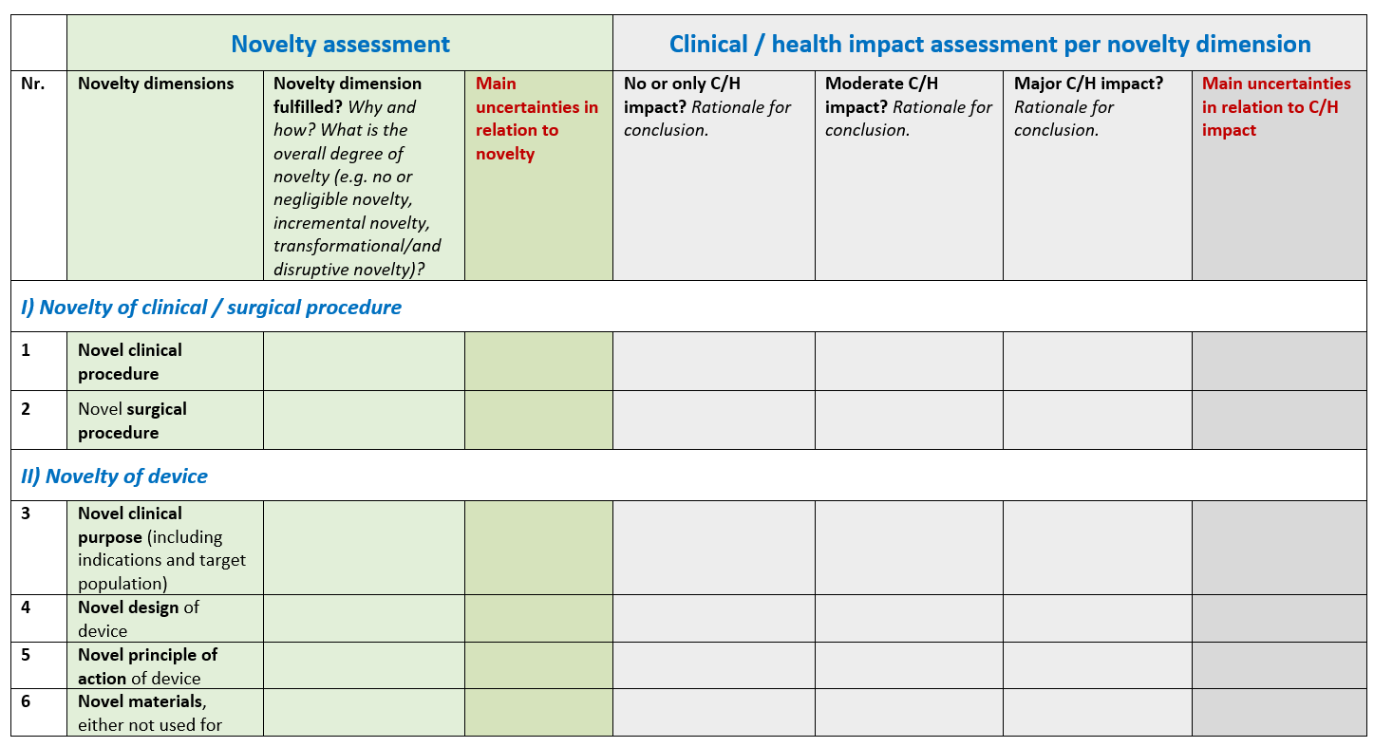
Assessment Matrix (optional tool)
Severity of possible impact
Novelty
dimensions

Slide 19

Uncertainties and decision making
?!
Novel devices will have no real world data but mainly data from optimised conditions
That means that ‘possible impacts’ may need to be estimated by experts based on to their own clinical experience. This involves uncertainties.
These need to be considered when making a decision
Uncertainties can also tip the balance towards a positive decision: for instance a high level of uncertainty may justify the need of an opinion, even if the impact severity does not appear major based on the data at hand

Slide 20
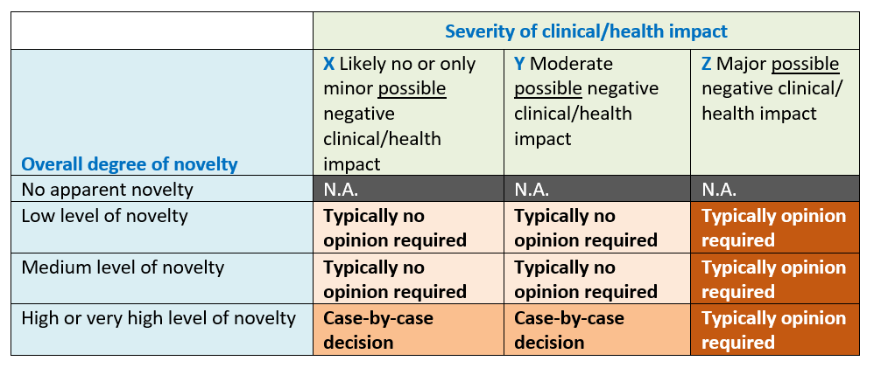
Decision Matrix (optional tool)
Need for an opinion may be justified due to a high level of uncertainty

Slide 21
1
Background and introduction
2
Criterion 1: novelty and resulting impacts
3
Criterion 2: scientifically valid health concerns
4
Criterion 3: significantly increased incidents
5
Overall assessment and available tools

Slide 22
Criterion 2: Scientifically valid health concerns
Scientifically valid health concerns in regard to components,
source materials or health impacts in case of device failure
resulting in a significant adverse change in the
benefit-risk profile of a specific category / group of devices
Information available?
Information reliable?
Relevant for device under assessment?
Criterion 2

Slide 23
Information on health concerns
If the Secretariat is in a position to forward information on health concerns (e.g. based on analyses of the MDCG group on post-market surveillance), this information may be based on systematic and careful analyses of the following data sources:
Post-market surveillance and vigilance activities of manufacturers:
  Reporting of serious incidents individually
  Periodic summary reports
  Field safety corrective actions
Periodic summary update reports by manufacturers, depending on class
Trend reports by manufacturers
Summary of safety and clinical performance by manufacturers

Slide 24
Health concerns based on knowledge and expertise of panel
In exceptional cases experts may have information on health concerns in relation to a specific group or category of devices (e.g. relevant scientific and clinical literature)
Both reliability and relevance of such information
for the device under assessment should be taken into account:
  Reliability: for example data quality, case numbers, robustness of evidence
  * Anecdotal evidence is not acceptable
  * Information relating to a product of only one manufacturer would typically not be considered sufficient to fulfil the requirement of ”specific group or category of devices”
  * Evidence should be traceable and documented in high-quality peer reviewed publications
  (e.g. conference abstracts are insufficient)
  Relevance: for example if the device under assessment is using the same or similar source materials and/or components as those used for the group or category of devices and where their use has led to health concerns
Need for a justification on reliability and relevance

Slide 25
1
Background and introduction
2
Criterion 1: novelty and resulting impacts
3
Criterion 2: scientifically valid health concerns
4
Criterion 3: significantly increased incidents
5
Overall assessment and available tools

Slide 26
Criterion 3: significantly increased rate of serious incidents
Concerns exclusively information provided from the Secretariat: where available, the Secretariat will provide information on significant increases of serious incidents of a specific category / group of devices
Such information does not necessarily trigger an opinion
The panel should carefully consider on a case-by-case basis if the serious incident related information is relevant for the device under assessment
Information available?
Relevant for device under assessment?
Criterion 3

Slide 27
1
Background and introduction
2
Criterion 1: novelty and resulting impacts
3
Criterion 2: scientifically valid health concerns
4
Criterion 3: significantly increased incidents
5
Overall assessment and available tools

Slide 28
Overall Assessment process
Simplified flowchart: ‘No’ decision exits not shown. A ‘no’ exit at any point closes the respective criterion.
Device under assessment
Novelty?
Clinical/health impact of novelty?
Determine degree of novelty & severity of clinical/health impact
Expert judgement based on clinical experience and taking uncertainties into account
Criterion 1
Yes
Yes
Information available?
Information reliable?
Information relevant for device under assessment?
Opinion required?
Yes
Yes
Expert judgement
Information from specific group/category of devices
Criterion 2
Information available?
Information relevant for device under assessment?
Criterion 3
Yes
Expert judgement

Slide 29
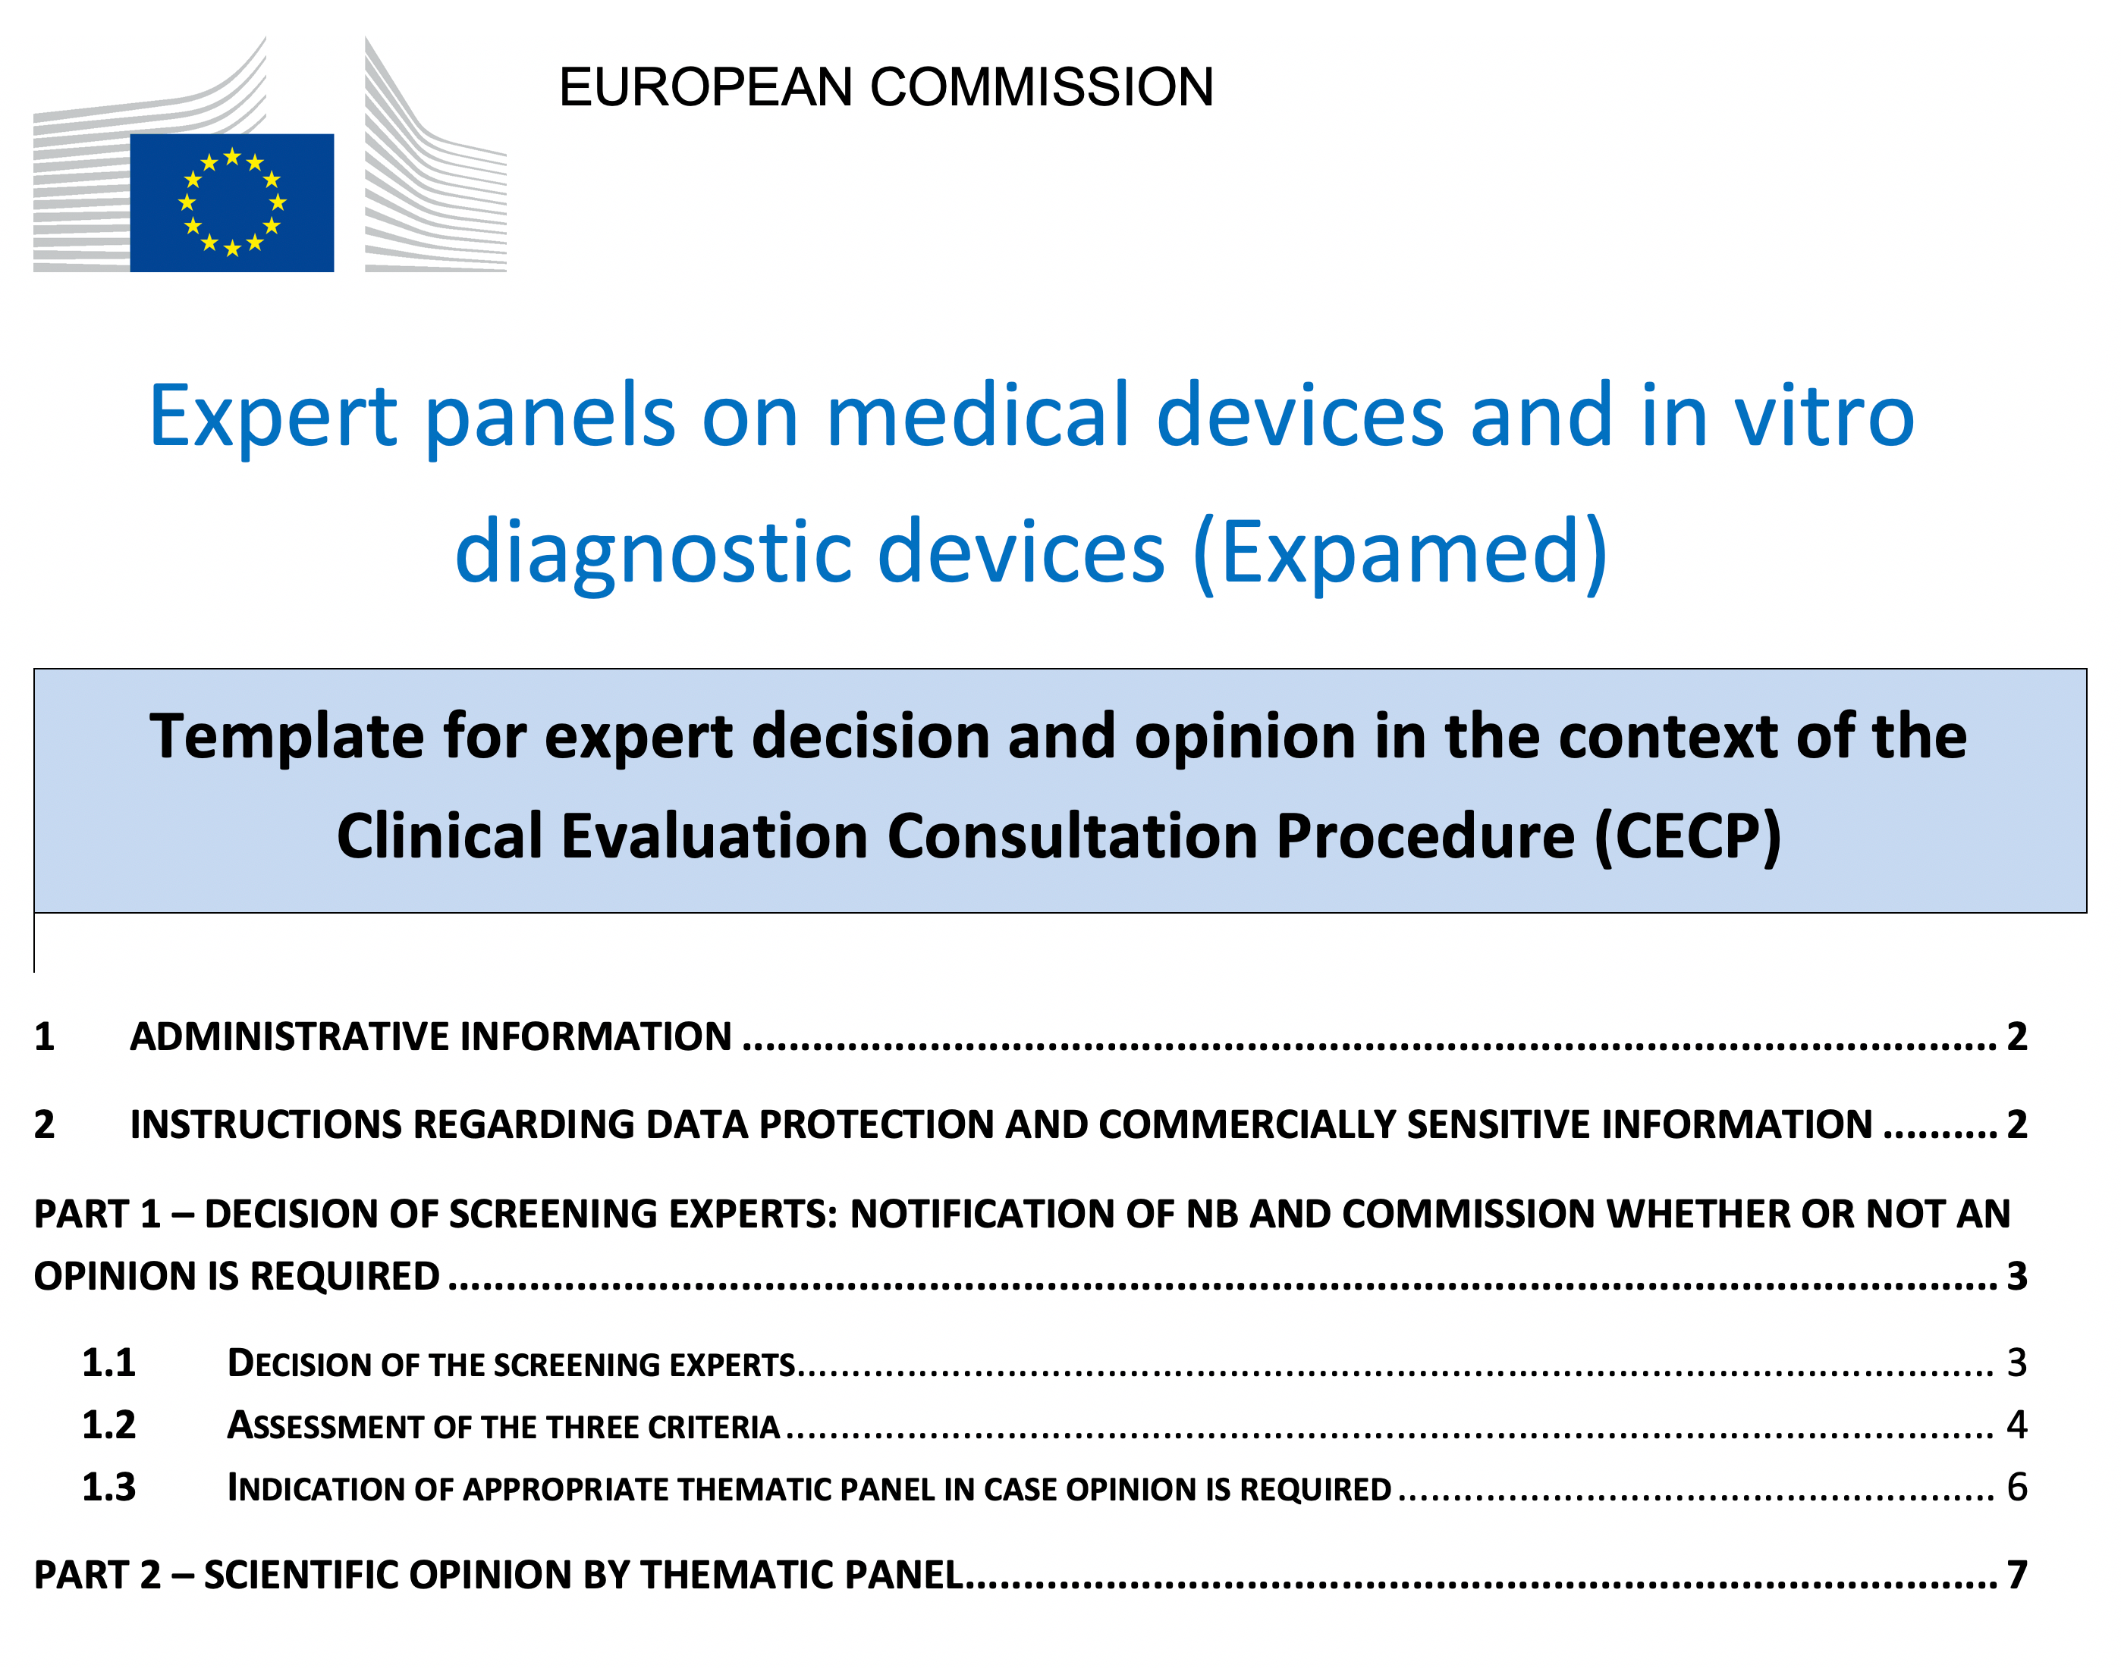
Mandatory documentation of screening decision
Expert panel template for CECP
Part 1 Decision whether opinion required
Summary table to be completed
by screening experts
MANDATORY REQUIREMENT
Part 2: Scientific Opinion
Template to be completed by thematic experts

Slide 30

Navigation guide for the screening step
Screening experts will receive an email with the following:
Navigation guide to the screening decision:
  Outlining a step-by-step approach regarding practical aspects
  and key elements
  Assessment Matrix: novelty versus severity of impact
  Decision Matrix: likelihood of opinion requirement
Commission Guidance Document
Template for expert decision and opinion, with administrative details and two parts to be completed by experts:
  Screening experts: summary table for documenting the assessment of the three criteria
  In case an opinion is required, the template will be passed on to the thematic panels,
  informing about the reasons as to why an opinion is required.
  Experts in the thematic panel will then complete the second part (scientific opinion)

Slide 31

Thank you
© European Union 2020
Unless otherwise noted the reuse of this presentation is authorised under the CC BY 4.0 license. For any use or reproduction of elements that are not owned by the EU, permission may need to be sought directly from the respective right holders.
Icons from Freepik.com

