Slide 1

Management of Conflict of Interests (COI) of experts
Training of members of Commission expert panels on medical devices and in vitro diagnostic devices (EXPAMED)

Slide 2
1
Legal basis – Experts’ obligations
2
Definition of a medical device company
3
Types of interests to be declared
4
Direct interests
5
Indirect interests
6
Declaration of interests using the DOI form
7
Assessment of experts' DOI and possible restrictions
8
Key messages

Slide 3
1
Legal basis – Experts’ obligations
2
Definition of a medical device company
3
Types of interests to be declared
4
Direct interests
5
Indirect interests
6
Declaration of interests using the DOI form
7
Assessment of experts' DOI and possible restrictions
8
Key messages

Slide 4

Legal basis – Experts’ obligations
Why do I have to declare my interests as a member of EXPAMED?
LEGAL OBLIGATION FOR EXPERTS
MDR Article 107
No interests in medical device industry affecting their impartiality
Declaration of direct / indirect interests
Obligation to update information on changing interests
Publicly available on the Commission website
LEGAL OBLIGATION FOR COMMISSION
MDR Art. 106(3)
Establish systems & procedures
Active management & prevention of potential CoI

Slide 5
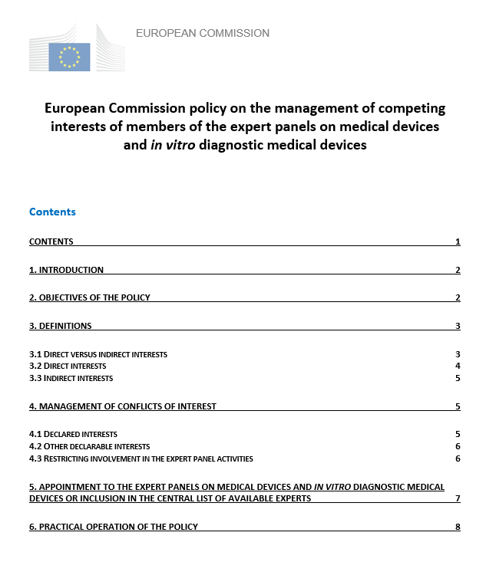
European Commission policy on the management of conflict of interests of EXPAMED
Based on the European Medicines Agency (EMA) policy
Securing the best expertise while ensuring that interests do not interfere with impartiality, objectivity & independence.
Dossier-specific exclusion of experts with conflicting interests in regard to certain companies or medical devices
In other cases restriction of experts’ in regard to the the role they can play

Slide 6
1
Legal basis – Experts’ obligations
2
Definition of a medical device company
3
Types of interests to be declared
4
Direct interests
5
Indirect interests
6
Declaration of interests using the DOI form
7
Assessment of experts' DOI and possible restrictions
8
Key messages

Slide 7

Definition of 'medical device company’ in the context of this COI policy
Legal or natural person
Activities : research, development, manufacturing, maintenance, marketing and/or distribution of medical devices (MD)
Includes companies to which activities are outsourced on a contractual basis.
Also included in the definition:
Notified Bodies (NBs)
Clinical Research Organisations (CROs)
Consultancy companies
providing advice / services to the above activities

Slide 8
Definition of 'medical device company' for the purpose of the policy on the management of CoI
Legal or natural persons, which do not fall within the scope of the above definition, are also considered as ‘medical device companies’ if :
- they control (i.e. own a majority stake in, or otherwise exercise a significant influence in the decision-making processes of the relevant medical device company),
- they are controlled by or
- they are under common control of a medical device company
Independent researchers and research organisations including universities and learned societies are excluded from the scope of this definition

Slide 9
1
Legal basis – Experts’ obligations
2
Definition of a medical device company
3
Types of interests to be declared
4
Direct interests
5
Indirect interests
6
Declaration of interests using the DOI form
7
Assessment of experts' DOI and possible restrictions
8
Key messages

Slide 10
Types of interests to be declared
Direct interests | Indirect interests
Employment with a medical device company | Principal investigator Investigator
Consultancy to a medical device company | Grant or other funding to an organisation / institution
Providing advice to a medical device company on issues such as future strategy, direction and development activities | Close family members
Financial interests

Slide 11
1
Legal basis – Experts’ obligations
2
Definition of a medical device company
3
Types of interests to be declared
4
Direct interests
5
Indirect interests
6
Declaration of interests using the DOI form
7
Assessment of experts' DOI and possible restrictions
8
Key messages

Slide 12
Direct interests: 1. Employment
Any form of occupation in a MD company
Part-time or full-time
Paid or unpaid
Employees of a NB, CRO or consultancy company fall under ‘employment with a MD company’
TYPES OF ROLES
Executive role
Lead role
Cross-product responsibility
Individual product responsibility

Slide 13
Direct interests: 2. Consultancy
Any activity where an expert provides expertise, advice, training etc. to a MD company or individual employees of a company
Regardless of contractual arrangements or remuneration
Occasional - NOT expert’s principal activity, i.e. consultancy is not the expert’s main source of income
CONSULTANCY TYPES
Individual product related
Cross product related / general (non-product related)

Slide 14
Direct interests: 3. Strategic advisory role
Participation in:
(scientific) advisory boards
steering committees
With right to vote / influence the output
And providing advice / opinions on:
(future) strategy
direction
development activities of a MD company
Regardless of contractual arrangements or remuneration
TYPES OF STRATEGIC ADVISORY ROLE
Individual product related
Cross product related / general (non-product related)
Outside this definition: Data Monitoring Committees (DMC) → considered as principal investigators

Slide 15
Direct interests: 4. Financial interests (current)
Compensation
Intellectual property
rights
Ownership
Compensation, fees, honoraria, grant or other funding including:
rents
sponsorships and fellowships
paid by a medical device company to the expert in a personal capacity
(co-) ownership / holding of:
stocks and shares
stock options
equities
bonds
partnership interest in the capital of the company
Patents
Trademarks
Know-how
Copyrights
NO NEED TO DECLARE:
Investment funds, pension funds and/or interests in non-nominal unit trusts or similar
IF diversified AND independently managed
NO NEED TO DECLARE:
Expenses for research work
Accommodation or travel expenses for conferences / seminars
Relating to a medical device
Owned by the individual
Individual is directly a beneficiary

Slide 16
1
Legal basis – Experts’ obligations
2
Definition of a medical device company
3
Types of interests to be declared
4
Direct interests
5
Indirect interests
6
Declaration of interests using the DOI form
7
Assessment of experts' DOI and possible restrictions
8
Key messages

Slide 17
Indirect interests: Investigators
ONLY for clinical investigations (CI) sponsored/instigated by a MD industry
Principal investigator
Investigator
Coordinating different centres of a multicentre CI
Leading investigator of a monocentre CI
Coordinating (principal) investigator signing the clinical investigation report
Responsible for the CI at a specific site
Member of the CI team:
performing critical investigation related procedures and
making important investigation related decisions
NOT including a national coordinating investigator in a multinational CI
Experts participating in Data Monitoring Committees (DMC) are considered as principal investigators

Slide 18
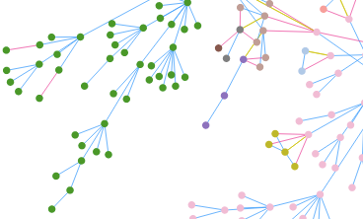
Indirect interests: Grants / Family members
Grant or other funding
to an organisation / institution
Close family members
Who?
first-line members of the expert’s family
(i.e. siblings, children and parents)
Spouse/ partner
Current direct interests
employment, consultancy, strategic advisory role, financial interests)
Any current funding from a MD company
To an organisation / institution to which the expert belongs
Or for which he/she performs any activity
AND used to support any expert’s activity

Slide 19
Other declarable interests
To be declared in SECTION 2.9 of the DOI form:
Academic investigations and publicly funded research / development initiatives
Membership in an ethics committee
For transparency it is advisable to declare also interests related to:
Systematic attendances to particular congresses covered by the same MD company
Having acted as testimonial or expert for patient organisations
Involvement in legal cases that were brought to court involving medical device companies

Slide 20
1
Legal basis – Experts’ obligations
2
Definition of a medical device company
3
Types of interests to be declared
4
Direct interests
5
Indirect interests
6
Declaration of interests using the DOI form
7
Assessment of experts' DOI and possible restrictions
8
Key messages

Slide 21
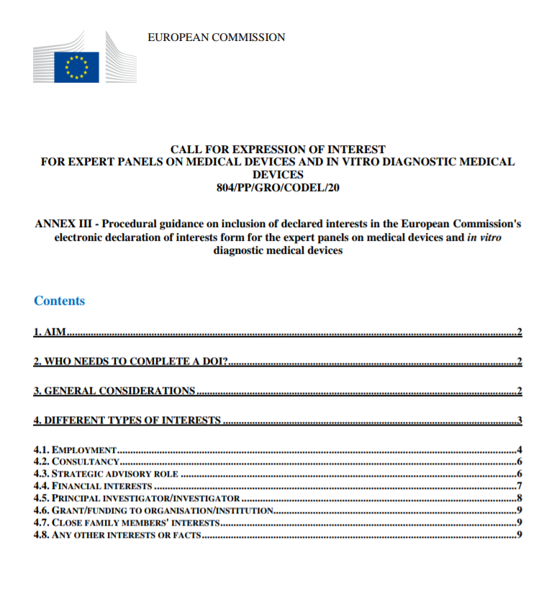
Declaration of Interests using the DOI form
WHEN?
At the time of application
At the time of appointment if circumstances changed
After appointment whenever a change of circumstances requires
Prior to start a specific panel task in case circumstances have changed
HOW?
DOI form
+ Guidance
All DOIs + CVs of the experts are made publicly available on the European Commission's website

Slide 22
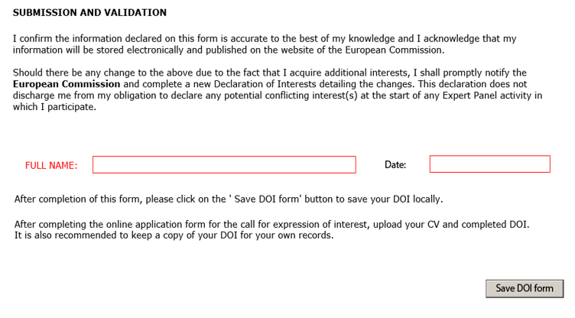
Declaration of Interests using the DOI form
Important:
Before submitting and validating their DOI form, experts need to SIGN the form by:
entering their full name and
stating the date of submission
The DOI form should be sent to the Secretariat the same date of the declaration at the following e-mail address:
EU-OPERATIONS-EXPAMED@EC.EUROPA.EU
Same legal validity like normal (handwritten) dated signature

Slide 23
1
Legal basis – Experts’ obligations
2
Definition of a medical device company
3
Types of interests to be declared
4
Direct interests
5
Indirect interests
6
Declaration of interests using the DOI form
7
Assessment of experts' DOI and possible restrictions
8
Key messages

Slide 24
Assessment of experts' DOI and possible restrictions
The Secretariat will restrict the involvement of experts in activities of the panels based on 3 factors:
the nature of the interest declared
the time since the interest occurred in relation to the date of the signed DOI form:
current interest
any time in the past (for employment in executive or lead role)
during the last 3 years (for all other interests)
the role of the expert in the panel: rapporteur, co-rapporteur, reviewing member

Slide 25
Assessment of experts’ DOI and possible restrictions
Fully allowed
Chair / Vice-Chair
COM assessment*
Possible restrictions to role of the expert in the panel
DOI form
Rapporteur / Co-rapporteur
For a specific medical device of a company
For any medical device of a company
Reviewing member
Commission COI policy document
Excluded
(MDR Art. 107)
* based on the Commission CoI management policy

Slide 26
1
Legal basis – Experts’ obligations
2
Definition of a medical device company
3
Types of interests to be declared
4
Direct interests
5
Indirect interests
6
Declaration of interests using the DOI form
7
Assessment of experts' DOI and possible restrictions
8
Key messages

Slide 27

Key messages for experts
Declaring interests is a legal obligation.
The Commission trusts that experts make complete and accurate declarations
Please be on the safe side: it is better to over-report interests than to under-report. In case of breach of trust the Commission reserves the right to take appropriate measures
Declaring an interest does not necessarily mean exclusion from expert panel work
If there are unclear points in the DOI instructions: raise it with your Chair for discussion within the Coordination Committee and Secretariat

Slide 28
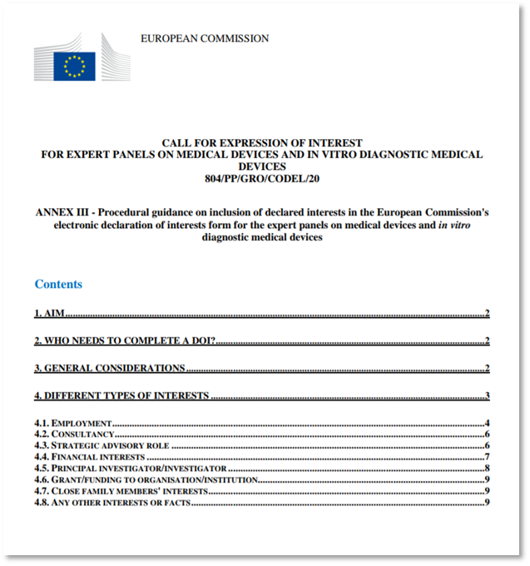
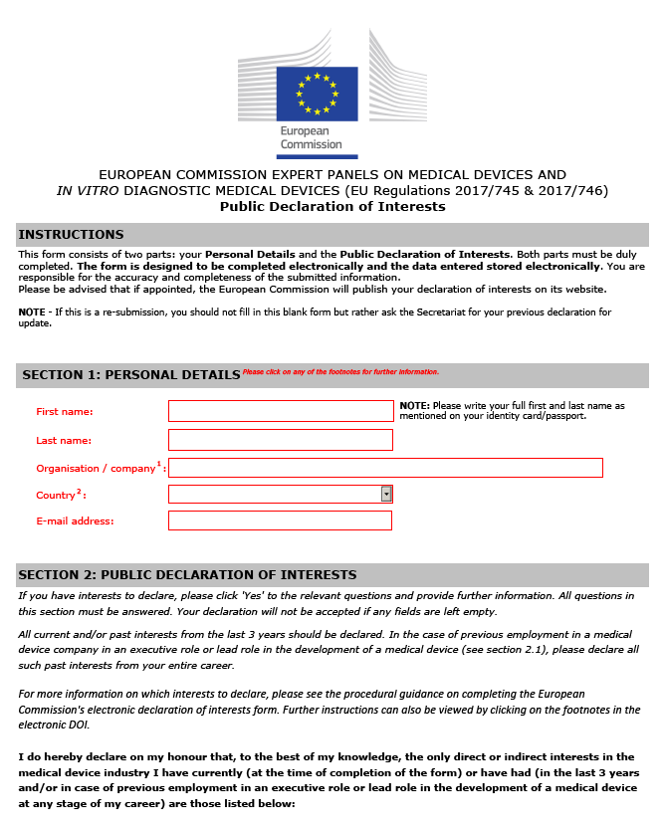
3 key documents regarding the conflicts of interests
Commission policy of handling COI
Call for expression of interest: Guidance for experts on DOI
DOI form

Slide 29
References
Regulation (EU) 2017/745 on medical devices (Art. 107)
European Commission policy on the management of competing interests of members of the expert panels on medical devices and in vitro diagnostic medical devices
Procedural guidance on inclusion of declared interests in the European Commission's electronic declaration of interests form for the expert panels on medical devices and in vitro diagnostic medical devices
Declaration of Interest (DOI) form
All the above documents are available on-line
on the expert space via the CIRCABC platform

Slide 30

Thank you
© European Union 2020
Unless otherwise noted the reuse of this presentation is authorised under the CC BY 4.0 license. For any use or reproduction of elements that are not owned by the EU, permission may need to be sought directly from the respective right holders.
Icons from Freepik.com

