Slide 1
Medical devices - Regulatory framework
Training of members of Commission’s expert panels on medical devices and in vitro diagnostic devices (EXPAMED)

Slide 2
Expert panels - functions
provide opinions on the clinical evaluation assessment reports on the notified bodies for certain high risk devices
provide views on the manufacturer’s performance evaluations of certain in vitro diagnostic medical devices
covering specific categories or groups of devices or specific hazards linked to these
provide scientific, technical, clinical assistance to the Commission, MDCG and Member States
contribute to the development and maintenance of guidance and common specifications
contribute to the development of international standards
provide opinions in response to consultation by manufacturers
contribute to the identification of concerns and emerging issues linked to devices

Slide 3
1
Introduction
2
Qualification and classification
3
Clinical investigation and evaluation
4
Conformity assessment
5
Post-Market surveillance
6
Vigilance
7
Market-Surveillance
8
Other relevant aspects

Slide 4
Key figures for the medical devices sector in EU*
more than 500.000 types of medical devices
730.000 employees
32.000 companies (95 % SMEs)
120 billion € EU market (27% EU market)
7,4 % of healthcare spending, i.e. 1% of EU GDP
8-10% of annual sales invested in R&D
14.000 new patents - second highest among all the sectors in Europe
Innovation driven (life cycle ~ 18 months)
* in 2019

Slide 5
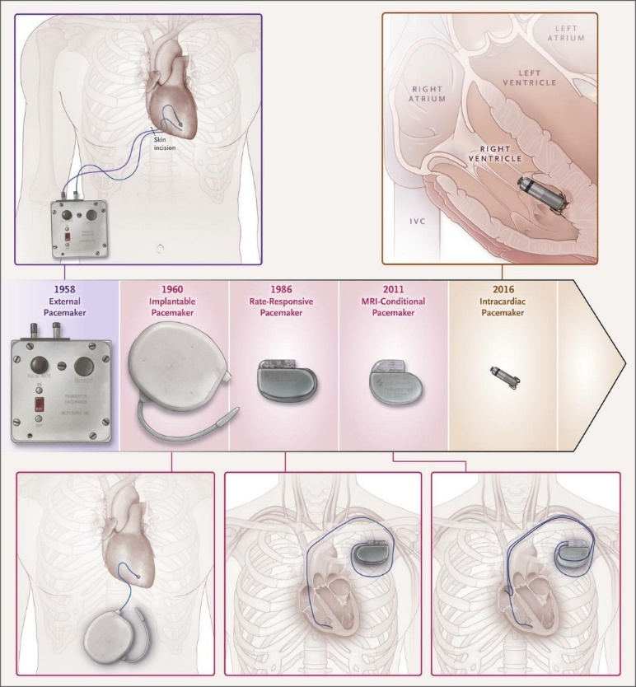
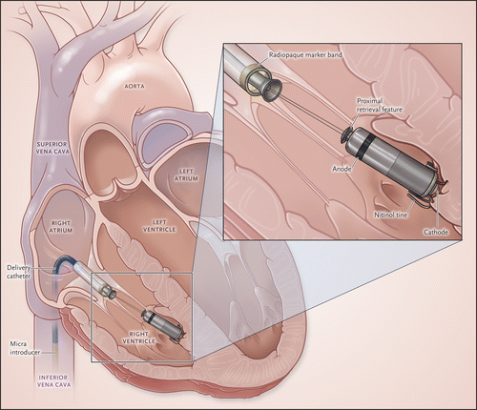
Iterative development vs. disruptive development

Slide 6
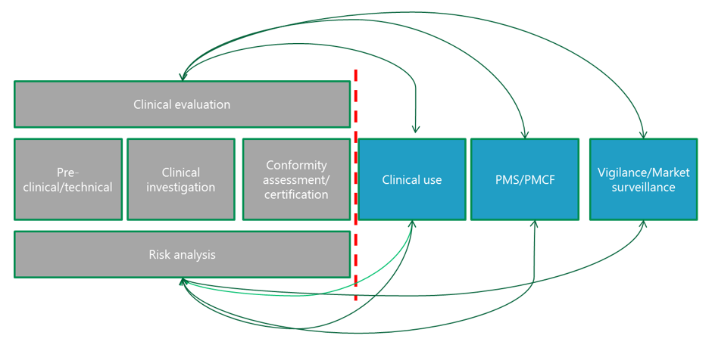
Life cycle approach

Slide 7
General areas of the regulatory framework
Pre-market
Post-market
Qualification &
classification
Post-market surveillance (manufacturer)
Vigilance
Clinical investigation & evaluation
Conformity assessment
Market surveillance
(competent authorities)

Slide 8
Examples of devices
Devices
Bone cements, bone void fillers
Sutures, absorbable sutures
IUDs
Blood bags
Disinfectants specifically intended for use with a medical device
Drug delivery pumps
Solutions for the transport of organs for transplant; IVF media
Accessories to medical devices
Contact lens care products
Gases used to drive surgical tools
Automated external defibrillator storage units
Annex XVI – products without a medical function
Cosmetic implants, dermal fillers, liposuction equipment, brain stimulation

Slide 9
Revision of the EU Medical Devices Legislation
Directive 90/385/EEC on active implantable medical devices Directive 93/42/EEC on medical devices
Regulation on medical devices – Regulation (EU) 2017/745
Directive 98/79/EC on in vitro diagnostic medical devices
Regulation on in vitro diagnostic medical devices – Regulation (EU) 2017/746

Slide 10
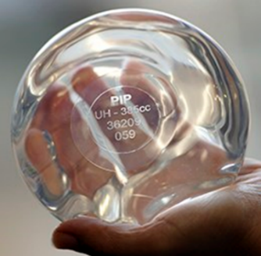
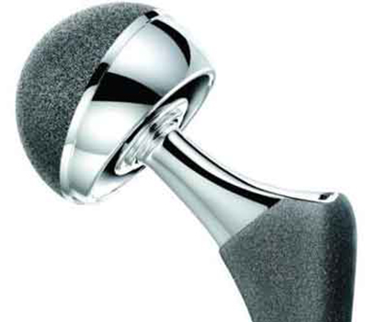
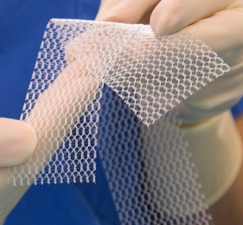
Why the revision
Adaptation to technological and scientific progress
Better protection of public health and better patient safety
Legal certainty and innovation-friendly environment
More transparency and patient empowerment
A more European approach
Restore the trust of the patients and clinicians
The implications of going from Directives to Regulations

Slide 11
Main new regulatory elements and key objectives
Reinforcement of the rules on generation of clinical evidence
Stricter pre-market control of certain high-risk devices with the involvement of a pool of experts at EU level
Inclusion of certain aesthetic devices within the scope
Reinforced designation and oversight processes of notified bodies.
New classification system for IVDs – 80% of IVDs now to be assessed by a Notified Body
Stricter requirements related to the use of hazardous substances for certain devices
Introduction of a UDI system
Strengthening of post-market surveillance for manufacturers
Stricter rules for "substance-based" devices

Slide 12
Transitional periods
25 May 2017
26 May 2021
26 May 2022
Entry into force of the Regulations
Full application of MDR
Full application of IVDR
26 May 2025: Maximum period of validity of certificates issued under current Directives
26 May 2026: Making available of devices placed on the market pursuant to current Directives

Slide 13
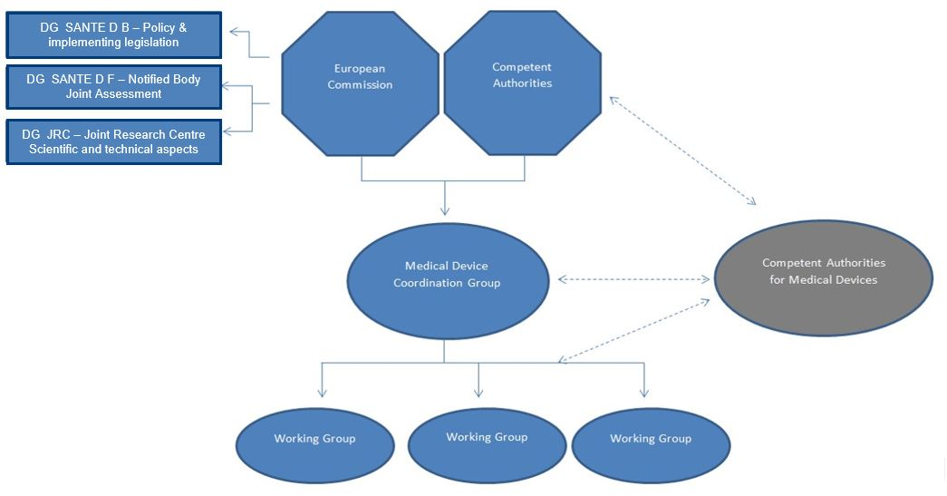
The European governance map for MD

Slide 14
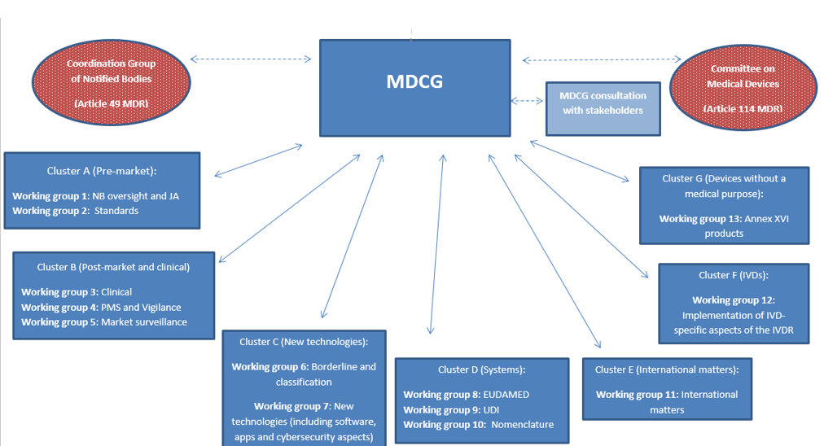
Medical Devices Coordination Group

Slide 15
1
Introduction
2
Qualification and classification
3
Clinical investigation and evaluation
4
Conformity assessment
5
Post-Market surveillance
6
Vigilance
7
Market-Surveillance
8
Other relevant aspects

Slide 16
Why are qualification and classification important?
Level and “strength” of clinical data
Specific consultation procedures
CECP/PECP
Consultation for ancillary medicinal substances
Consultation for tissues & cells
Consultation for TSE
Post-market surveillance – PMSR/PSUR
Summary of Safety and Clinical Performance
Implant cards
Traceability

Slide 17
Qualification
Medical device
In vitro diagnostic medical device
Medicine
ATMP
Human blood, blood products, plasma or blood cells of human origin
Transplants, tissues or cells of animal origin, or their derivatives
Transplants, tissues or cells of human origin, or their derivatives
Other viable biological material
Biocide
Cosmetic
Food

Slide 18
Who decides on qualification & classification?
The manufacturer
Confirmed by notified body
If dispute, referred for decision to the Competent Authority
CAs may consult each other in the MDCG Borderline and Classification Working Group – informal
EU Commission can decide by Implementing Acts – examination procedure i.e. MS vote

Slide 19
What is a medical device?
‘medical device’ means any instrument, apparatus, appliance, software, implant, reagent, material or other article intended by the manufacturer to be used, alone or in combination, for human beings for one or more of the following specific medical purposes:
— diagnosis, prevention, monitoring, prediction, prognosis, treatment or alleviation of disease,
— diagnosis, monitoring, treatment, alleviation of, or compensation for, an injury or disability,
— investigation, replacement or modification of the anatomy or of a physiological or pathological process or state,

Slide 20
— providing information by means of in vitro examination of specimens derived from the human body, including organ, blood and tissue donations,
and which does not achieve its principal intended action by pharmacological, immunological or metabolic means, in or on the human body, but which may be assisted in its function by such means.
The following products shall also be deemed to be medical devices:
— devices for the control or support of conception;
— products specifically intended for the cleaning, disinfection or sterilisation of devices as referred to in Article 1(4) and of those referred to in the first paragraph of this point.

Slide 21
Factors determining classification
The risk classes are: I, IIa, IIb and III - Annex VIII
Intended purpose of the devices and their inherent risks due to:
duration of contact with the body
degree of invasiveness
local vs. systemic effect
potential toxicity
the part of the body affected by the use of the device – most critical use
if the device depends on a source of energy
The strictest rule will apply

Slide 22
Other relevant definitions & concepts
‘accessory for a medical device’ means an article which, whilst not being itself a medical device, is intended by its manufacturer to be used together with one or several particular medical device(s) to specifically enable the medical device(s) to be used in accordance with its/their intended purpose(s) or to specifically and directly assist the medical functionality of the medical device(s) in terms of its/their intended purpose(s);
‘intended purpose’ means the use for which a device is intended according to the data supplied by the manufacturer on the label, in the instructions for use or in promotional or sales materials or statements and as specified by the manufacturer in the clinical evaluation;

Slide 23
Other relevant definitions & concepts
‘implantable device’ means any device, including those that are partially or wholly absorbed, which is intended:
— to be totally introduced into the human body, or — to replace an epithelial surface or the surface of the eye,
by clinical intervention and which is intended to remain in place after the procedure.
Any device intended to be partially introduced into the human body by clinical intervention and intended to remain in place after the procedure for at least 30 days shall also be deemed to be an implantable device;

Slide 24
Other relevant definitions & concepts
‘active device’ means any device, the operation of which depends on a source of energy other than that generated by the human body for that purpose, or by gravity, and which acts by changing the density of or converting that energy. Devices intended to transmit energy, substances or other elements between an active device and the patient, without any significant change, shall not be deemed to be active devices.
Software shall also be deemed to be an active device;

Slide 25
Other relevant definitions & concepts
‘invasive device’ means any device which, in whole or in part, penetrates inside the body, either through a body orifice or through the surface of the body;
‘procedure pack’ means a combination of products packaged together and placed on the market with the purpose of being used for a specific medical purpose;
‘system’ means a combination of products, either packaged together or not, which are intended to be inter- connected or combined to achieve a specific medical purpose;

Slide 26
Other relevant concepts
Duration of use
Body orifice
Surgically invasive device
Active therapeutic device
Active device intended for diagnosis and monitoring
Central circulatory system
Central nervous system
Injured skin or mucous membrane

Slide 27
Device classification – non-invasive
Default – I (R1)
Channel or store body liquids – IIa (R2)
Blood bags – IIb
Modify composition of human tissues or cells –IIb (R3)
Filter, centrifuge, exchange gas or heat – IIa
Substances for in vitro contact with cells – III
Injured skin (R4) - IIa
Mechanical barrier, compression or absorption – I
Deep injuries – IIb

Slide 28
Device classification – invasive
Body orifices (R5)
Transient use – I, short term – IIa, long term – IIb
Surgically invasive for transient or short-term use – IIa (R6, R7)
Reusable surgical instruments – I
Ionising radiation – IIb
Biological effect or absorbed – IIb
Hazardous administration of medicinal substance – IIb
Direct contact with heart, circulatory system or central nervous system – III
Implantable or surgically invasive for long term use – IIb (R8)
In teeth – IIa
Biological effect or absorbed – IIb
Direct contact with heart, circulatory system or central nervous system – III
Intended to undergo chemical change in the body – III
Administer of medicinal substance – III
Active implants, breast implants, surgical meshes, joint replacements, spinal column implants – III

Slide 29
Device classification – active
Default – I (R13)
Administer or exchange energy – IIa (R9)
Hazardous – IIb
Monitor/control active IIb devices – IIb (R9)
Monitor/control active implantable devices – III (R9)
Emit ionising radiation – IIb (R9)
Illumination – I (R10)
For diagnosis and monitoring of patient – IIa (R10)
Vital parameters – IIb
Radiology devices – IIb
Administer or remove medicinal products – IIa (R12)
Hazardous – IIb
Integrated diagnostic function – III (R22)

Slide 30
Device classification – active, software
Default – I (R14)
Make decisions – IIa
Potential serious deterioration of health – IIb
Potential death or irreversible deterioration – III
Monitor physiological functions - IIa
Vital parameters - IIb

Slide 31
Device classification – special rules
Ancillary medicinal product – III (R14)
Contraception or STD prevention – IIb (R15)
Implantable or long-term invasive – III
Specific disinfection of medical devices by non-mechanical means – IIa (R16)
Disinfection of invasive devices at endpoint – IIb
Contact lens cleaning/hydration – IIb
Recording of X-ray images – IIa (R17)
Devices with non-viable tissues of human or animal origin – III (R18)
Not if animal origin and contact with intact skin only

Slide 32
Device classification – special rules
Nanomaterials: consider potential for internal exposure (R19)
High or medium – III, low – IIb, negligible – IIa
Administer medicinal products by inhalation – IIa (R20)
If essential impact on medicinal product or life-threatening conditions – IIb
Devices composed of substances or combinations of substances that are absorbed or locally dispersed – IIb (R21)
Nasal or oral cavity – IIa
Stomach or lower gastrointestinal tract – III
Systemically absorbed – III

Slide 33
Class I Shoe covers
Reusable surgical instruments
Defibrillator storage units
Examination gloves
Class IIa Refrigerator for blood & plasma
Diagnostic ultrasound machine
Magnetic resonance imaging system
Bacterial/viral filter for use on patient
Hydrocolloid plaster for blisters
Positron emission tomography
Dental filling materials
Class IIb Infusion pumps
In vivo dosimeters
Ventilators
Movement monitor for babies
Diagnostic devices emitting ionizing radiation
Class III Sweat cards with pilocarpine
Cardiac catheters
Breast implants
Surgical meshes
Joint replacements
Drug-eluting stents
Dura guard for craniotome
Prosthetic heart valves
Valve repair devices
Ablation catheters
Pathogen inactivation system for platelets

Slide 34
1
Introduction
2
Qualification and classification
3
Clinical investigation and evaluation
4
Conformity assessment
5
Post-Market surveillance
6
Vigilance
7
Market-Surveillance
8
Other relevant aspects

Slide 35
Enhanced requirements for clinical evidence
Definition of equivalence
Implantable + class III generally require clinical investigation
Consideration of alternatives
Justification of the level of evidence
SSCP
Common Specifications + CECP/PECP

Slide 36
Equivalence
Clinical
Purpose
Technical
Design
Biological
Same materials or substances
Site
Population
Specifications
Properties
Contact with same tissue

Slide 37
Notified Body’s clinical competence
GSPR
ISO / CS / Guidance
RMS
Clinical evaluation
The device they are assessing
Conformity Procedures
NB Employees
External Clinical Experts
Decision maker on CE marking

Slide 38
Enhanced requirements for clinical evidence
“Confirmation of conformity with relevant general safety and performance requirements set out in Annex I under the normal conditions of the intended use of the device, and the evaluation of the undesirable side-effects and of the acceptability of the benefit-risk ratio […] shall be based on clinical data providing sufficient clinical evidence […]. To that end, manufacturers shall plan, conduct and document a clinical evaluation […]”
“In the case of implantable devices and class III devices, clinical investigations shall be performed” some exemptions apply

Slide 39
What are the sources of clinical data
‘clinical data’ means information concerning safety or performance that is generated from the use of a device and is sourced from the following:
— clinical investigation(s) of the device concerned,
— clinical investigation(s) or other studies reported in scientific literature, of a device for which equivalence to the device in question can be demonstrated,
— reports published in peer reviewed scientific literature on other clinical experience of either the device in question or a device for which equivalence to the device in question can be demonstrated,
— clinically relevant information coming from post-market surveillance, in particular the post-market clinical follow-up;

Slide 40
What is considered clinical evidence (MDR)
‘clinical evaluation’ means a systematic and planned process to continuously generate, collect, analyse and assess the clinical data pertaining to a device in order to verify the safety and performance, including clinical benefits, of the device when used as intended by the manufacturer;
‘clinical evidence’ means clinical data and clinical evaluation results pertaining to a device of a sufficient amount and quality to allow a qualified assessment of whether the device is safe and achieves the intended clinical benefit(s), when used as intended by the manufacturer;

Slide 41
Types of Reports
CI report & summary
PMCF Plan, PMS Plan, PSUR (IIb + III)
PMCF Evaluation Report + SSCP (III and implantable)
CER / CEAR

Slide 42
Clinical evidence – relevant for CECP
Clinical Evaluation Consultation Procedure – a scientific opinion on the clinical evaluation assessment report of the notified body, on the background of the manufacturers clinical evaluation documentation
Manufacturer
Clinical evaluation report
Clinical evaluation plan
Post market clinical follow-up plan (or a justification why not applicable)
Post market clinical follow-up report (if available)
Notified body
Clinical evaluation assessment report

Slide 43
Clinical evidence – relevant for PECP
Performance Evaluation Consultation Procedure – a view on the performance evaluation report of the manufacturer
Manufacturer
Performance evaluation report
‘clinical evidence’ means clinical data and performance evaluation results, pertaining to a device of a sufficient amount and quality to allow a qualified assessment of whether the device is safe and achieves the intended clinical benefit(s), when used as intended by the manufacturer;

Slide 44
Clinical evaluation and PMCF
'clinical data’ means information concerning safety or performance that is generated from the use of a device and is sourced from the following: […]
clinically relevant information coming from post-market surveillance, in particular the post-market clinical follow-up;
"The clinical evaluation and its documentation shall be updated throughout the life cycle of the device concerned with clinical data obtained from the implementation of the manufacturer's PMCF plan […] and the post-market surveillance plan referred to in Article 84." (Article 62(11))
Clinical work has to be continued after the product has been placed on the market – it becomes a continuous task like post-market surveillance.

Slide 45
Post-market clinical follow-up - PMCF
a continuous process that updates the clinical evaluation
shall be addressed in the manufacturer's post-market surveillance plan
shall collect and evaluate clinical data from the use in or on humans of a device which bears the CE marking
confirming the safety and performance throughout the expected lifetime of the device; ensuring the continued acceptability of identified risks; detecting emerging risks

Slide 46
1
Introduction
2
Qualification and classification
3
Clinical investigation and evaluation
4
Conformity assessment
5
Post-Market surveillance
6
Vigilance
7
Market-Surveillance
8
Other relevant aspects

Slide 47
New Legislative Framework (NLF)
To improve the internal market for goods and strengthen the conditions for placing a wide range of products on the EU market, the new legislative framework was adopted in 2008. It is a package of measures that aim to improve market surveillance and boost the quality of conformity assessments. It also clarifies the use of CE marking and creates a toolbox of measures for use in product legislation.
The new legislative framework consists of:
Regulation (EC) 765/2008 setting out the requirements for accreditation and the market surveillance of products
Decision 768/2008 on a common framework for the marketing of products, which includes reference provisions to be incorporated whenever product legislation is revised. In effect, it is a template for future product harmonisation legislation
Regulation (EC) 764/2008 laying down procedures relating to the application of certain national technical rules to products lawfully marketed in another EU country

Slide 48


New Legislative Framework
Conformity against requirements established by the legislation (MDR/IVDR) is confirmed by the CE marking of conformity and the issuance of the declaration of conformity signed off by the manufacturer
Devices bear the CE merking
Manufacturer’s declaration of conformity

Slide 49
New Legislative Framework
GENERAL SAFETY AND PERFORMANCE REQUIREMENTS
ANNEX I MDR/IVDR
General Safety and Performance Requirements establish main rules and principles on safety and performance of devices. However, they do not set specific technical solutions to be put in place in order to comply with such requirements.
In order to bear the CE marking, devices have to comply with all applicable requirements.

Slide 50


Harmonised Standards
Manufacturers can make use of harmonised standards in order to demonstrate compliance with the applicable requirements.
The approach taken under the new legislative framework is in line with the continuous fast speed advancement of sectors such as medical devices. Technical specifications and solutions to be adopted by manufacturers are not laid down by the legislation, which would otherwise risk to get soon obsolete.
Harmonised standards are developed in order to provide techcnial solutions to demonstrate compliance with the mandatory legal requirements.

Slide 51
Harmonised Standards
The use of harmonised standards remains voluntary. Manufacturers, other economic operators, or conformity assessment bodies are free to choose another technical solution as long as compliance can be demonstrated
If harmonised standards, or the relevant part of them, are applied, they provide presumption of conformity with the concerned requirements of the Regulations (Article 8)
Harmonised standards have a broad scope, they may be addressing either one specific technology/type of devices (e.g. EN ISO 5840:2005 Cardiovascular implants - Cardiac valve prostheses ISO 5840:2005) or a wide-ranging group of devices (e.g. EN ISO 14971:2019 Application of risk management to medical devices)
Where no harmonised standards exist or are not sufficient or there is a need for public health Common specifications may be adopted

Slide 52
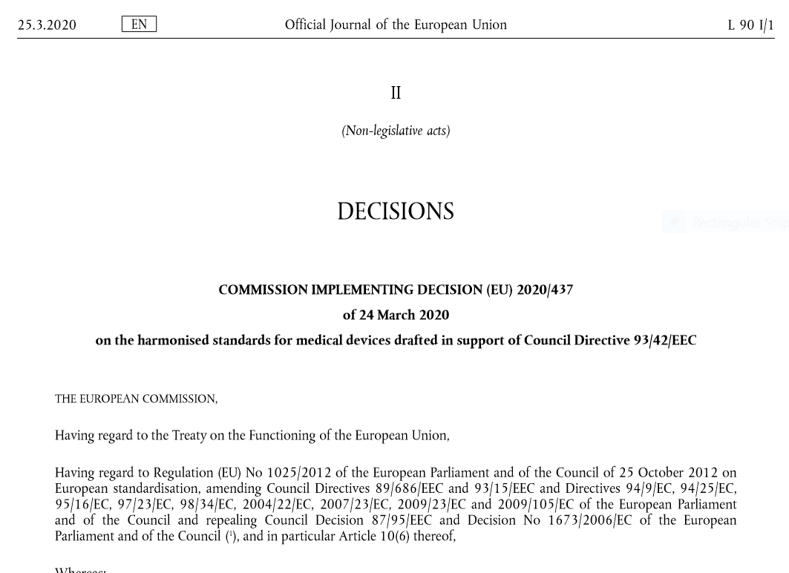
Harmonised Standards
A harmonised standard is a European standard developed by a recognised European Standards Organisation: CEN, CENELEC, or ETSI. It is created following a request from the European Commission to one of these organisations.
264 harmonised standards are currently listed in the EU Official Journal in support of MDD
Standardisation mandate under the MDR/IVDR under preparation

Slide 53
Conformity Assessment Procedures (NLF)
Manufacturer
Design and manufacturing of the product in accordance to GSPR
Certification issued by NB (for Class Im, Is, Ir, II, III)
Declaration of conformity
(for ALL devices)
Notified Body
Placing on the market of the device
Surveillance/
Monitoring
Designation
53
53
National Authority

Slide 54
Comparison with Medicines Regime based on an authorisation
Authorisation of manufacturing site(s)
Development and testing according to Directive 2001/83/EC
Drawing up of the dossier
Application for marketing authorisation
Examination of application
Issuing of marketing authorisation
Placing on the market of the medicinal product

Slide 55
Conformity Assessment Procedures - Modules
DESIGN
MANUFACTURING
Procedures to be used when performing conformity assessment in respect of particular products as set out in DECISION No 768/2008/EC
MODULE A
MODULE C
MODULE D
MODULE B
MODULE E
MANUFACTURER
MODULE F
MODULE G
MODULE H
55

Slide 56
Conformity Assessment Procedures MDR/IVDR
Match between modules set out in DECISION No 768/2008/EC and Annexes of the MDR*
* Analogous procedures are established in the IVDR, not mentioned for easy of reference
Annex IX
Module H
Annex X
Module B
Annex XI Part A
Module D
Annex XI Part B
Module F
Article 19 + Annexes II&III
Module A
56

Slide 57
Applicability per device class
 | Annex I: general safety & performance requirements | Annex II & III: technical documentation and documentation on PMS | Annex IX: quality management system and assessment of technical documentation | Annex X: type examination | Annex XI: product conformity verification | Annex XIII: Custom-made devices
Class I
Class I sterile, measuring, reusable surgical instruments |  |  | or Chapter I & III |  | part A
Class IIa |  |  | or Chapter I & III |  | part A
Class IIb |  |  | or Chapter I & III
Class III |  |  | or
Custom-made

Slide 58
Conformity Assessment Procedures - class III
CLASS III
Annex IX
Conformity assessment based on a quality management system and on assessment of technical documentation
Annex X
Conformity assessment based on type-examination
Annex XI
Conformity assessment based on product conformity verification
CLASS III IMPLANTABLE :
Clinical Evaluation Consultation Procedure (point 5.1 to Annex IX) is part of the conformity assessement
SPECIFIC ADDITIONAL PROCEDURES
Devices incorporating a medicinal substance
Devices manufactured utilising, or incorporating, tissues or cells of human or animal origin, or their derivatives, that are non-viable or rendered non-viable
Devices that are composed of substances or of combinations that are absorbed by or locally dispersed in the human body

Slide 59
Conformity Assessment Procedures – class IIb
CLASS IIb
Annex X
Conformity assessment based on type-examination
Annex XI
Conformity assessment based on product conformity verification
Chapters I and III of Annex IX
Conformity assessment based on a quality management system and on assessment of technical documentation
Assessment of the technical documentation as specified in Section 4 of Annex IX of at least one representative device per generic device group
CLASS IIb ACTIVE DEVICES INTENDED TO ADMINISTER AND/OR REMOVE A MEDICINAL PRODUCT :
Clinical Evaluation Consultaiton Procedure
(point 5.1 to Annex IX) is part of the conformity assessment
In case of class IIb implantable device, the assessment of technical documentation shall apply for every device
59

Slide 60

CE Marking – Involvement of notified bodies
For all devices but class I devices and for certain aspects relating to class I devices supplied sterile, with measuring functions or being a reusable surgical instrument, compliance of devices has to be verified by a third-party entity , named NOTIFIED BODY. Involvement of the notified body is proportionate to he inherent risk of the device and depends on the conformity assessment procedure followed.

Slide 61

Certificate
EU Quality Management System Certificate
EU Technical Documentation Assessmnt Certificate
EU Type-Examination Certificate
EU Quality Assurance Certificate
EU Product Verification Certificate
Following a posivite conformity assessement, the notified body will issue a EU certificate (depending on the conformity assessment procedure followed). It will certify the conformity assessment procedure followed, providing assurance that compliance against the applicable requirements has been verified for all devices in the scope.

Slide 62
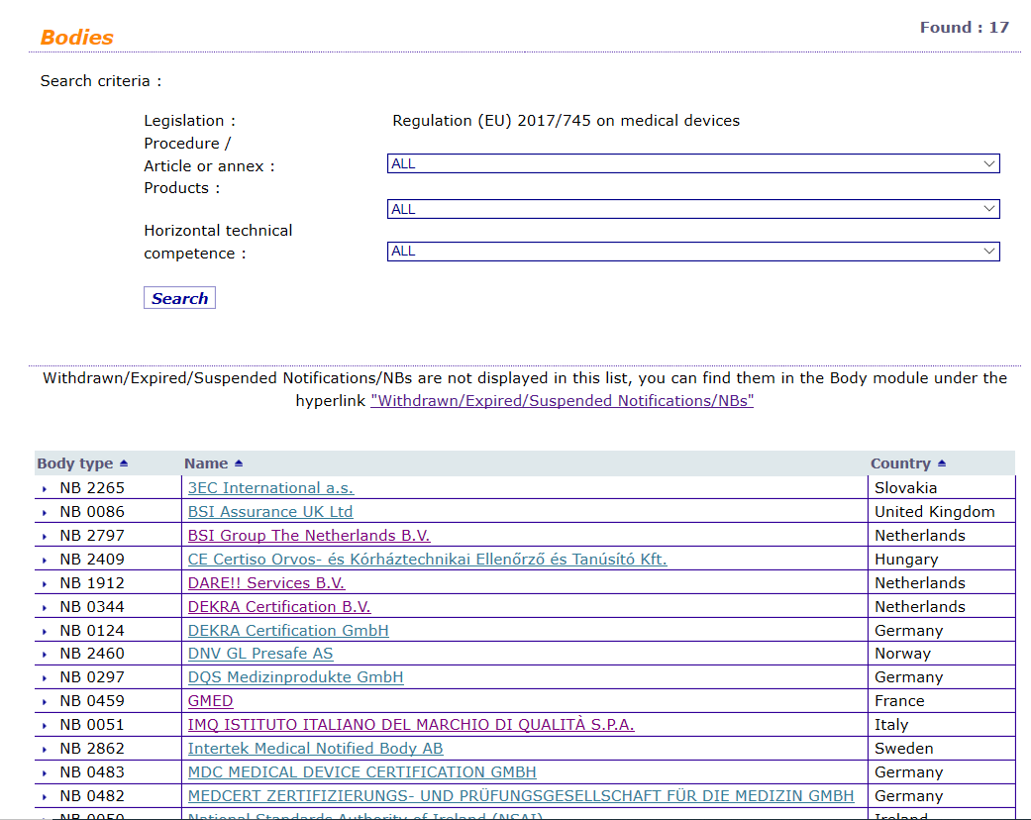

Notified Bodies
Notified Bodies are entities, either public or provate, performing third-party conformity assessment activities including calibration, testing, certification and inspection according to MDR/IVDR
Notified Bodies are designated by national authorities and notified to the Commission. The Commission assign a four-digit identification number to each notified body.
The list of desiganted notified bodies is available in NANDO (New Approach Notified and Designated Organisations) Information System).
List of notified bodies under the MDR
https://ec.europa.eu/growth/tools-databases/nando/index.cfm?fuseaction=directive.notifiedbody&dir_id=34
List of notified bodies under IVDR
https://ec.europa.eu/growth/tools-databases/nando/index.cfm?fuseaction=directive.notifiedbody&dir_id=35

Slide 63
Desigansion of Notified Bodies – Joint Assessement Process
PRE-ASSESSMENT AND OFF-SITE ACTIVITIES
NB’s application
DECISION ON DESIGNATION
ON-SITE-ASSESSMENT ACTIVITIES
Organisation of the no-site assessment
DA’s completeness check
Trasmission of the application to the COM
DA’s review of the application
Trasmission of the PAR to the COM
JAT appointment and scheduling and announcement of on-site assessment
Dissemination of information to JAT
Assessment of the application
Coordination between DA and JAT
POST-ASSESSMENT ACTIVITIES
On-site assessment
List of non-compliances
Summary of the JAT assessment
Request for a CAPA plan within a specific deadline
JAT remaining diverging opinions
DA’a assessment of the CAPA plan
JAT’s review of the CAPA plan
Feedback to the NB on the assessment on the CAPA plan
Final DA’s review on the implementation of the CAPA plan
DA’s final assessment report and submission to the COM
JAT final opinion
MDCG’s recommendation on the draft designation
DA’s final decision on designation

Slide 64
Requirements to be met by Notified bodies
Organisation and General Requirements (Legal Status, Organisational Structure, Independence and Impartiality, Confidentiality, Liability, Finantial requirements and partecipation in coordination activities)
Quality management Requirements
Resources Requirements (Qualification Criteria, documentation on qualification, training and authorisation, subcontractors and external experts and monitoring of competences and excange of experience)
Process Requireements (pre-application activities, application reviews and contracts, allocation of resources, conformity assessment activities, final review, decisions and certifications, changes and modifications, surveilance and post-certification and re-certification)

Slide 65
1
Introduction
2
Qualification and classification
3
Clinical investigation and evaluation
4
Conformity assessment
5
Post-Market surveillance
6
Vigilance
7
Market-Surveillance
8
Other relevant aspects

Slide 66
Obligations of the Manufacturers
NEW - “establish, implement, document and maintain a risk management system”, (Annex I, S3)
Risk management is defined as
“a continuous iterative process throughout the entire lifecycle of a device, requiring regular systematic updating. In carrying out risk management manufacturers shall:[…]

Slide 67
Post-market surveillance
actively and systematically gather, record and analyse relevant data on the quality, performance and safety so as to draw the necessary conclusions and to determine, implement and monitor any preventive and corrective actions
for each device a post-market surveillance system will be established and continuously maintained, in a manner that is proportionate to the risk class;
Post-market surveillance plan
Post-market surveillance report
Periodic safety update report
"Manufacturers of devices shall implement and keep up to date the post-market surveillance system in accordance with Article 83."

Slide 68
Post-market surveillance
A proactive and systematic process to:
update the benefit-risk determination
update the clinical evaluation
collect data on side-effects
document serious incidents
detect and report trends
improve performance and safety
New medical and scientific knowledge will also be submitted by the manufacturer to the notified body

Slide 69
1
Introduction
2
Qualification and classification
3
Clinical investigation and evaluation
4
Conformity assessment
5
Post-Market surveillance
6
Vigilance
7
Market-Surveillance
8
Other relevant aspects

Slide 70
Vigilance – aspects of interest
Manufacturers need to collect and report to the competent authorities
all serious incidents involving devices made available on the Union market, except expected side-effects
trends
field safety corrective actions (FSCA) and field safety notices (FSN)
Central reporting – Eudamed
Analysis of vigilance data in Eudamed to identify trends, patterns or signals in the data that may reveal new risks or safety concerns
Enhanced coordination between authorities
Possible under reporting from hospitals

Slide 71
Vigilance – relevant definitions
‘serious incident’ means any incident that directly or indirectly led, might have led or might lead to any of the following: (a) the death of a patient, user or other person, (b) the temporary or permanent serious deterioration of a patient's, user's or other person's state of health, (c) a serious public health threat
‘serious public health threat’ means an event which could result in imminent risk of death, serious deterioration in a person's state of health, or serious illness, that may require prompt remedial action, and that may cause significant morbidity or mortality in humans, or that is unusual or unexpected for the given place and time

Slide 72
Vigilance – relevance for the panels
Screening criteria for CECP (Annex IX, 5.1 (c) (ii) & (iii))
Identification of reasonable concerns for Commission and MDCG to request scientific advice

Slide 73
1
Introduction
2
Qualification and classification
3
Clinical investigation and evaluation
4
Conformity assessment
5
Post-Market surveillance
6
Vigilance
7
Market-Surveillance
8
Other relevant aspects

Slide 74
Market surveillance – general aspects
A system put in place by the competent authorities perform appropriate checks on the conformity characteristics and performance of devices including laboratory checks when needed
Based on annual surveillance plans
Annual summaries of the results made available to the other authorities
Enhanced coordination between authorities

Slide 75
1
Introduction
2
Qualification and classification
3
Clinical investigation and evaluation
4
Conformity assessment
5
Post-Market surveillance
6
Vigilance
7
Market-Surveillance
8
Other relevant aspects

Slide 76
Other relevant Aspects
Benefit-risk determination
Eudamed
https://ec.europa.eu/growth/sectors/medical-devices/new-regulations/eudamed_en
Transparency
Registries

Slide 77
Benefit-Risk determination
‘benefit-risk determination’ means the analysis of all assessments of benefit and risk of possible relevance for the use of the device for the intended purpose, when used in accordance with the intended purpose given by the manufacturer;
benefit-risk ratio
“[…] provided that any risks which may be associated with their use constitute acceptable risks when weighed against the benefits to the patient and are compatible with a high level of protection of health and safety, taking into account the generally acknowledged state of the art.” Annex I (1)
“All known and foreseeable risks, and any undesirable side-effects, shall be minimised and be acceptable when weighed against the evaluated benefits to the patient and/or user arising from the achieved performance of the device during normal conditions of use.” Annex I (1)

Slide 78
Transparency
Transparency and access to information
Public Clinical Investigations Report and Summary
Public Field Safety Corrective Actions and Field Safety Notices
Summary of Safety and Clinical Performance
More detailed IFUs and labelling
Implant cards
Devices and their certificates

Slide 79
Resources
Main page of the new Regulations
https://ec.europa.eu/growth/sectors/medical-devices/new-regulations_en
Resources for health care professionals and health institutions
https://ec.europa.eu/growth/sectors/medical-devices/getting-ready-new-regulations/healthcare-professionals-and-health_en
Information kit and various resources
htps://ec.europa.eu/growth/sectors/medical-devices/new-regulations/spread-word_en

Slide 80

Thank you
© European Union 2020
Unless otherwise noted the reuse of this presentation is authorised under the CC BY 4.0 license. For any use or reproduction of elements that are not owned by the EU, permission may need to be sought directly from the respective right holders.
Icons from Freepik.com

