Slide 1

Roles and tasks of panels and experts:
Terms of Reference
Rules of Procedure
Handling commercially confidential information
Training of members of Commission expert panels on
medical devices and in vitro diagnostic devices (EXPAMED)

Slide 2
Part 1 – Terms of Reference for expert panels

Slide 3
1
The roles of expert panels
2
The expert panels landscape
3
Current roles and tasks - CECP/PECP
4
Specific scope of CECP/PECP

Slide 4
1
The roles of expert panels
2
The expert panels landscape
3
Current roles and tasks - CECP/PECP
4
4
Specific scope of CECP/PECP

Slide 5
Expert roles in MDR can be seen as falling into two broad categories
Medical devices Regulation (MDR)
Recital 83
IVD Regulation (IVDR)
Recital 53
Article 50.3
ad hoc advice
Expertise & assistance in relation to the implementation of the MDR,
including advice on safety & performance of specific high risk devices
Advice on safety & performance of
specific high-risk devices
routine advice in the context of regulatory procedures
Review clinical evaluation assessment reports of notified bodies:
‘CECP’ = clinical evaluation consultation procedure
Review performance evaluation reports:
PECP = performance evaluation consultation procedure

Slide 6
Overview of the roles of expert panels
Roles
Timelines
Articles
Task
Requester(s)
Risk classes
MDR IVDR
Phased in later
Implementation of MDR
Guidance & CS on clinical investigations & evaluation, PMCF, performance studies & evaluation & PMPF…
Guidance on clinical / performance evaluation
Standards
Identification of concerns
106.10
COM
MDCG
Ad hoc
mandate
ad hoc
advice
Any device
Not
Legally
fixed
Flexible
MFR
NB
MS
106.11
Advice on the criteria for appropriate data sets for conformity assessment
55.3
MDCG
(COM)
Class III implantable
Class IIb ARMP*
Class D IVDs
50.3
Scientific advice on safety & performance
61.2
Consultations on MFRs clinical development strategy & proposal for clinical investigations
MFR
Class III
Class IIb ARMP*
Fixed mandate for CECP/PECP
(MDR/IVDR)
routine
advice
NB
(COM
for reporting)
Legally
fixed
54
Mandatory consultation procedures:
  CECP
  PECP
Class III implantable
Class IIb ARMP*
Class D IVDs**
48.6
* ARMP = Administer and/or Remove Medicinal Products
** class D IVDs for which no common specifications exist and where it is the first certification for that specific type of device

Slide 7
1
The roles of expert panels
2
The expert panels landscape
3
Current roles and tasks - CECP/PECP
4
4
Specific scope of CECP/PECP

Slide 8
Expert panel landscape; 4 panels will require sub-groups
A) Medical Devices Regulation
Screening panel
Panel x
Thematic expert panels and possible sub-groups:
Sub-group 1
Sub-groups
1. Orthopaedics, traumatology, rehabilitation, rheumatology
Sub-group 3
Sub-groups
Sub-group 2
Coordination Committee
Chairs & Vice Chairs of 10 MDR panels +
IVD panel and representatives of screening panel
2. Circulatory system
Sub-groups
3. Neurology
4. Respiratory system, anaesthesiology, intensive care
5. Endocrinology and diabetes
Central list of available experts
Temporary assignment of experts to panels.
Reserve list for appointments
Sub-groups
6. General and plastic surgery and dentistry
7. Obstetrics and gynaecology, incl. reproductive medicine
8. Gastroenterelogy and hepatology
9. Nephrology & urology
10. Ophthalmology
B) In vitro diagnostics Regulation
11. In vitro diagnostic devices

Slide 9
JRC proposal for possible sub-groups of the four large thematic panels
Panels will have final say. However, this scheme was already used for
rather complex budgetary calculations & planning.
1. Orthopaedics, traumatology, rehabilitation, rheumatology
1. Joint replacements
(load bearing)
3. Spinal devices
2. Joint replacements (non-load bearing)
4. Non-articulating devices, rehabilitation
2. Circulatory system
1. Prosthetic valves &
heart valve repair
3. Active implantable
cardiac devices
5. Cardiac
surgery
2. Cardiovascular stents
4. Structural interventions
3. Neurology
1. Central and peripheral nervous system devices
3. Neurosurgical devices
2. Implants for
hearing and vision
6. General and plastic surgery and dentistry
1. Surgical implants and general surgery
3. Maxillofacial surgery, dentistry
2. Plastic surgery and wound care

Slide 10
1
The roles of the expert panels
2
The expert panels landscape
3
Current roles and tasks - CECP/PECP
4
Specific scope of CECP/PECP

Slide 11
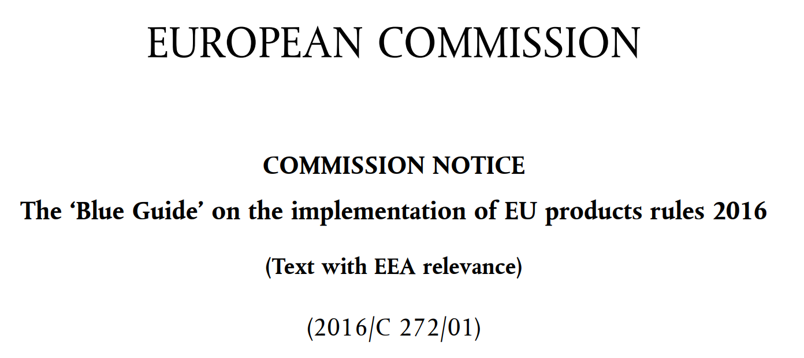
Wider context of CECP/PECP: the ‘new approach’
The regulatory framework for medical devices is based on the so-called ‘new approach’ to technical harmonisation and standards.
The new approach requires a close relationship between EU law and standardisation requests by the Commission.
In essence: the legislation outlines only ‘essential requirements’ for safety and other aspects. Technical details are provided in EU ‘harmonised standards’ used to facilitate compliance with the essential requirements.
Products manufactured in accordance with the harmonised standards are presumed to be in conformity with the essential requirements (= ‘presumption of conformity’) and can circulate freely on the single market.
In case no (adequate) harmonised standard exists, the Commission can issue so-called ‘Common Specifications’.
Expert Panels

Slide 12
Wider context of CECP/PECP: conformity assessment
Assessment of whether or not a product fulfils the essential requirements is not done by Competent Authorities, but ‘outsourced’ to notified bodies (NBs), designated by the authorities.
Notified Bodies establish whether a product conforms with the requirements (CE marking) and can thus circulate on the single market– the process is called ‘conformity assessment’
Key legal obligations for manufacturers relevant in this context are:
  Quality management system including
  risk management.
  Known and foreseeable risks must be weighed against benefits for the patient (benefit risk ratio)
Expert Panels

Slide 13

CECP/PECP and expert panels
In the context of their conformity assessments, notified bodies (NBs) are legally obliged to consult expert panels for specific high-risk devices:
  For medical devices:
  clinical evaluation consultation procedure (CECP)
  For in vitro diagnostic devices:
  performance evaluation consultation procedure (PECP)
However, the advice by expert panels is
not legally binding. NBs have to consider the advice but may
decide not to follow it (fully). However, in such cases NBs need to justify why they did not follow the expert panel advice.
In case there is no opinion within the legal timeline, the NB can continue with conformity assessment.

Slide 14
Clinical evaluation consultation procedure (CECP) for medical devices and
Performance evaluation consultation procedure (PECP) for diagnostics
NB
Decide whether dossier requires procedure
Expert panels
Commission
European
Parliament
Council
Member States
MDR: Clinical evaluation consultation procedure (CECP)
Step 1:
decision by 2 experts
whether opinion required
Step 2:
scientific opinion
on CEAR
Yearly report
Screening Panel
10 thematic
expert panels and sub-groups
Annual report outlining:
Devices that went into procedure
Notifications of NBs regarding whether or not CECP applicable
Cases where NBs did not follow the panel opinion
Dossier
3 decision criteria
Opinion on NB’s Clinical Evaluation Assessment Report
IVDR: Performance evaluation consultation procedure (PECP)
Dossier
IVD panel
Views on MF’s Performance Evaluation Report

Slide 15
Timelines for CECP and PECP
Expert panels
MDR: Clinical evaluation consultation procedure (CECP)
Step 1:
decision by 2 experts
whether opinion required
Step 2:
scientific opinion
on CEAR
Screening Panel
10 thematic
expert panels and sub-groups
3 decision criteria
21 days
60 days
from receipt of documents
IVDR: Performance evaluation consultation procedure (PECP)
IVD panel
60 days
from receipt of documents

Slide 16
1
The roles of the expert panels
2
The expert panels landscape
3
Current roles and tasks - CECP/PECP
4
Specific scope of CECP/PECP

Slide 17
Legislator’s intentions regarding CECP and PECP
MDR Recital 56 and IVDR Recital 53
“Should lead to harmonised evaluation of high-risk medical devices/ in vitro diagnostic medical devices by sharing expertise on clinical aspects/performance aspects
Developing common specifications on categories of devices that have undergone the consultation process”

Slide 18
CECP and PECP compared
CECP (medical devices)
PECP (in vitro diagnostic devices)
Expert panel review
Expert panel review
NB’s clinical evaluation assessment report (CEAR)
MF’s performance evaluation report
(PER)
based on MF’s clinical evidence
based on MF’s
The clinical evaluation report (CER)
The clinical evaluation plan (CEP)
The post-market follow-up plan (PMCF)
The PMCF evaluation report (where available)
                Scientific validity report
                Analytical performance report
                Clinical performance report
Taking into consideration:
Stakeholder information received from the Secretariat (where available)

Slide 19
CECP and PECP: scope of review
CECP (medical devices)
PECP (in vitro diagnostic devices)
Expert panel review
Expert panel review
Should address…
Should address…
NB’s assessment of:
The sufficiency of the manufacturer’s clinical evidence and the sufficiency in general
The adequacy of the benefit-risk determination
The consistency of clinical evidence with
    The medical indication(s)
    The PMCF plan
Justification for the approach taken to gather the clinical evidence
Methodology, protocol and report of a literature review
The technology on which the device is based, its intended purpose and claims made about the device's performance or safety
Nature & extent of the scientific validity and the analytical and clinical performance data evaluated
The clinical evidence for acceptable performance compared to the state of the art in medicine

Slide 20
Part 2 – Rules of Procedure for expert panels

Slide 21
1
Core principles of the expert panels
2
Roles of experts & decision making
3
Organisation of the expert panels
4
Some key rules & procedures

Slide 22
1
Core principles of the expert panels
2
Role of experts & decision making
3
Organisation of the expert panels
4
Some key rules & procedures

Slide 23
Five core principles governing the work of the expert panels
    Scientific competence and expertise
Independence, impartiality and objectivity
Declaration of interests (DOI)
Declaration on confidentiality
Declaration on commitment
Transparency
    Confidentiality
To be completed and signed by the experts
    Commitment

Slide 24
1
Core principles of the expert panels
2
Roles of experts & decision making
3
Organisation of the expert panels
4
Some key rules & procedures

Slide 25

Screening panel experts (only CECP)
2 experts per dossier:
RAPPORTEUR / CO-RAPPORTEUR
Selected by the Secretariat among the screening panel experts based on medical area/expertise required for the specific dossier
Experts decide whether or not an opinion is required and complete the relevant part of the template with the decision. If no consensus: specific provisions in Rules of Procedure
Rapporteur delivers the decision by uploading the template on CIRCABC
21 days

Slide 26
Composition of thematic panels
Thematic expert panel
Chair of the panel
Chair
Vice-Chair
Vice-chair of panel.
Acting as reviewing member, rapporteur or co-rapporteur unless required to replace or support the Chair
Rapporteur
x
Rapporteur, assigned for specific dossier
Co-Rapporteur
Co-Rapporteur, assigned for specific dossier
Reviewing member with voting rights
x
Reviewing member excluded from participation in regard to dossier

Slide 27
Roles within thematic panel
Chair
Coordinates the expert panel work
Manages decision making (consensus or majority)
Assigns, in collaboration with the Secretariat, a rapporteur and co-rapporteur for each dossier (rotating roles) based on the DOI assessment of the Secretariat
Requests additional expertise if needed (interaction with Secretariat)
Vice-Chair
Replaces the Chair when he/she cannot fulfil his/her role
May support the Chair in fulfilling his/her responsibility (useful for larger panels)
Otherwise: can act as rapporteur, co-rapporteur or reviewing member
Rapporteur / co-rapporteur
Rapporteur and co-rapporteur draft scientific opinion/view under supervision of chair
Rapporteur is responsible for providing the draft documents to the Chair
within time for consensus decision making.
Rapporteur uploads final opinion/view on CIRCABC (=deliverable)
Reviewing members
Panel members supporting the rapporteur / co-rapporteur with their expertise and have voting rights in regard to the dossier
Temporarily assigned expert
Assigned by the Secretariat from central list/other panel on ad hoc basis for limited period based on workload/expertise
Notified Bodies representatives
Permitted by the Chair in agreement with Secretariat to present their conclusions on the clinical evaluation from the manufacturer – Annex IX 5.1 (b)

Slide 28
Decision-making procedure in thematic expert panels
Opinion/view to be adopted by consensus by all panel members assigned to the dossier
(i.e. without COI): Chair, Vice-chair, Rapporteur, Co-rapporteur & Reviewing Members
CHAIR
manages decision-making
THEMATIC PANEL
Vice Chair
YES
Chair
C
V
M
OPINION ADOPTED in case of divergent positions, they must be mentioned
X
M
R
Consensus
M
M
M
Consensus?
M
X
M
O
NO
Outcome decided by majority
SECRETARIAT determines voting rights based on experts’ DOIs
X
=excluded due to COI

Slide 29
1
Core principles of the expert panels
2
Roles of experts & decision making
3
Organisation of the expert panels
4
Some key rules & procedures

Slide 30
Organisation of the expert panels
SECRETARIAT
Overall coordination, supervision and support
Thematic
expert panels
Permanent advisors (= members)
Temporary advisors from central list or other panels if needed
Acts at the request of the Secretariat
In charge of scientific opinions (CECP) and views (PECP)
Expert panels
sub-groups
Established in agreement with the Secretariat (permanent or ad-hoc basis)
Composed of expert panels’ members
Sub-groups elect Chair and Vice-Chair
Sub-groups manage routine and ad-hoc advisory tasks independently from parent panel but need to report to the parent panel
Screening panel
Permanent advisors (= members)
Temporary advisors from central list or other panels if needed
Acts at the request and under supervision of the Secretariat
In charge of decision whether to provide scientific opinion (CECP)
Coordination Committee
Chairs & Vice- Chairs of all expert panels
Acts at the request of the Secretariat
Supports efficient and uniform operation of the panels
Feedback on the work of the Screening Panel
At least 1 meeting/year

Slide 31
Roles of the Commission secretariat
Horizontal roles
Dossier & assignment
Review process
  Monitor compliance with Rules of Procedure
  Publish scientific advice of panels and, where necessary, justifications of notified bodies in case these do not follow expert advice
  Continuous monitoring of expert engagement & dossiers
  Issuing of contracts & budgetary planning & reimbursement depending on timely and satisfactory delivery
  Chair panels/sub-groups in case of duly justified cases & emergencies
  Organize and chair meetings of Coordination Committee
  Collect information on devices for yearly report by Commission (CECP only)
  NB’s dossier completeness check
  Supervise screening step
  (CECP only)
  Process requests for additional expertise
  Conflict of interest (COI) management
  Where available transmit:
  Information criteria 2 and 3 to screening panel
  Stakeholders’ information
  Remind experts of timelines
  Organise VCs in particular in view of decision making
  Assign experts without COI for relevant roles
  CIRCABC
  access
  Check completeness of expert panel advice
CECP/PECP process

Slide 32
1
Core principles of the expert panels
2
Roles of experts & decision making
3
Organisation of the expert panels
4
Some key rules & procedures

Slide 33
Fundamental obligations of experts
Active & substantial contribution to remote work and meetings
Adhere to Terms of Reference, Rules of Procedure and Handling Instructions of confidential information
Follow Commission guidance on the consistent interpretation of the screening decision criteria
Use secured IT tools (CIRCABC platform) and follow the Operational procedures
Use the templates and forms for delivering output via CIRCABC

Slide 34
CIRCABC as data hub for CECP/PECP
Secure CIRCABC Interest group ‘CECP & PECP’ EXPERT SPACE
Secretariat provides access rights
:
Dossier specific folder
Experts
Dossier documentation
Download
Decision
(only CECP)
Upload
Opinion / View
Upload

Slide 35
Term of office & renewal of term
TERM OF OFFICE AND RENEWAL OF TERM
EXPERT PANELS
CENTRAL LIST
Experts are appointed for a maximum of 3 years and their term can be renewed if the conditions for membership are still fulfilled.
If experts resign before end of term: Secretariat seeks to assign experts from central list for the remaining duration of the term
Validity - 5 years from the date of its establishment
Date of validity will be published on the Commission webpage

Slide 36

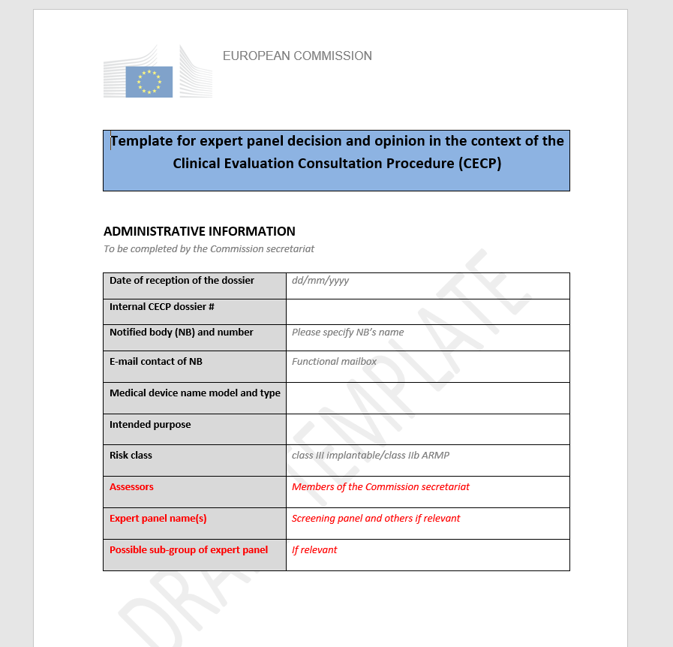
Information from stakeholders
Stakeholders’ input
  Expert panels must consider all relevant information provided by stakeholders (e.g., patients’ organisations and healthcare professionals) when preparing their scientific opinions
Secretariat
Where available, this information will be provided by the Secretariat
Expert panels
Scientific opinions (CECP) and views (PECP)

Slide 37


Provision of advice by written procedure
CECP & PECP
Written procedure is always used to delivery of:
  Scientific opinions in response to CECP
  Scientific views in response to PECP
  No physical meetings will take place for routine
  regulatory advice due to legal timelines and the fact that
  conformity assessment is delegated to Notified Bodies
Ad hoc advice
Ad hoc advice (e.g., contribution to common specifications, guidance documents)
may be based on both, physical meetings and written procedure

Slide 38



Communication - the Chair
Communicates with his panel members preferentially through e-mail
Can convene teleconferences in order to advance the panel’s deliberations
May request the Secretariat to arrange a videoconference, especially to expedite the deliberations of an expert panel including decision-making
Ideally, video-conferences organised by the Secretariat should be limited to those required to resolve contentious issues and/or making decisions on opinions/views
Coordination Committee
Secretariat
Chair
Panel 1
Secretariat
Chair
Panel 2

Slide 39

Communication - the Secretariat
Expert panel members and the Secretariat communicate preferentially by email
(non-confidential information only)
Physical meetings (e.g. Coordination Committee meeting) are organised by the Secretariat and held on Commission premises
    The Secretariat, under the responsibility of the Chair, drafts minutes of physical meetings and of videoconferences organised by the Secretariat

Slide 40

Use of 3 functional mailboxes
EU-OPERATIONS-EXPAMED
@ec.europa.eu
For communications in regard
to the scientific advice of the panels:
Work of the screening panel, thematic panels and Coordination Committee
Expert use it to furnish their updated DOIs
SANTE-EXPAMED
@ec.europa.eu
For Communications in regard to:
Formal appointment as expert of the screening and thematic panels, e.g. resignations,
term renewal etc.
EU-CONTRACTS-EXPAMED
@ec.europa.eu
For all issues in relation to
expert contracts and
payments

Slide 41

Communication – obligations of experts
Experts should make efforts to respond within 3 working days to requests
In particular…
If an expert notices a Conflict of Interest in relation to a specific dossier, he must inform the Secretariat and update his DOI
Experts should inform the Secretariat and the Chair in case of unavailability
The rapporteur is responsible for providing the draft documents to the Chair in a timely fashion so as to allow sufficient time for decision-making by consensus or majority
And for uploading the final deliverable (screening decision, opinion / view) on CIRCABC

Slide 42
Part 3 – Principles of handling commercially confidential information

Slide 43
Handling commercially confidential information
Within Commission such information is considered “sensitive non-classified” (SNC)
SNC needs to be labelled in agreement with Security notice C(2019) 1904
‘Handling Instructions and Security Measures for the Commission Expert Panels’
CECP dossier may contain ‘commercially confidential information and trade secrets’
Notified bodies
Secretariat
Experts
Must mark the relevant CECP/PECP documents with:
the security marking SENSITIVE
the distribution marking RELEASABLE TO: EXPERT PANELS (EXPAMED)
Checks the accuracy of the markings applied by NBs on their documentation
Ensure that experts are aware of the Handling instructions
Must download their CECP/PECP dossiers from CIRCABC
Transmission via e-mail is not allowed for reasons of data security

Slide 44

Handling commercially confidential information
Handling Instructions and Security Measures for the Commission Expert Panels
Professional secrecy for any information or document received as expert (Article 339 of the Treaty)
Secure SNC information when not in use (stored in a locked office or a locked cupboard)
Do not read or edit documents in public places. Electronic copies stored on platforms only accessible by the target audience
Do not keep paper/electronic files of the documents or any information beyond 30 days from a task finalisation
Remove immediately documents from printers, photocopiers, faxes or other shared devices
Shred paper documents and purge documents stored on electronic media

Slide 45
Background documents
[MDR] Regulation (EU) 2017/745 of the European Parliament and of the Council of 5 April 2017 on medical devices, amending Directive 2001/83/EC, Regulation (EC) No 178/2002 and Regulation (EC) No 1223/2009 and repealing Council Directives 90/385/EEC and 93/42/EEC, Official Journal of the European Union, L 117, 5th May 2017, pp. 1-175
[IVDR] Regulation (EU) 2017/746 of the European Parliament and of the Council of 5 April 2017 on in vitro diagnostic medical devices and repealing Directive 98/79/EC and Commission Decision 2010/227/EU, Official Journal of the European Union, L 117, 5th May 2017, pp. 176-332
Commission Implementing Decision (EU) 2019/1396 of 10 September 2019 laying down the rules for the application of Regulation (EU) 2017/745 of the European Parliament and of the Council as regards the designation of expert panels in the field of medical devices, Official Journal of the European Union, L 234, 11th September 2019, pp. 23-30
Call for expression of interest for expert panels on medical devices and in vitro diagnostic medical devices, 804/PP/GRO/CODEL/20/, Official Journal of the European Union, C 323, 27th September 2019, pp. 93-99
[ToR] Terms of Reference of the European Commission Expert Panels on Medical Devices and In Vitro Diagnostic Medical Devices (EXPAMED)
[RoP] Rules of Procedure of the European Commission Expert Panels on Medical Devices and In Vitro Diagnostic Devices
Handling instructions based on the European Commission Security Notice on Marking and handling of sensitive non-classified information, C(2019) 1904 final, 5th March 2019

Slide 46
Reference documents/tools
Methodology | Reference documents /tools
What are the roles and tasks of the experts panels?
How do panels operate and what are the roles of individual experts?
What tools can experts use for the screening decision criteria?
What are the routine operational procedures? How should experts use IT tools for data exchange/handling?
How should experts document their decisions and advice?
Terms of
Reference
Annex II of expert contract: ToR
Rules of Procedure
Handling
confidential information
Commission Guidance on screening decision criteria
Templates & Tools
Operational procedures
CIRCABC data exchange/handling
Expert panel templates
CECP/PECP

Slide 47
Roles of the Coordination Committee in regard to the Rules of Procedure
Discussing, amending, adopting the Rules of Procedure in agreement with Secretariat
Reviewing the Rules of Procedure at least every 3 years
Proposing procedural improvements when needed

Slide 48
Thank you
© European Union 2020
Unless otherwise noted the reuse of this presentation is authorised under the CC BY 4.0 license. For any use or reproduction of elements that are not owned by the EU, permission may need to be sought directly from the respective right holders.

