Slide 1

Workflow, operations and IT aspects
Training of members of Commission expert panels on
medical devices and in vitro diagnostic devices (EXPAMED)

Slide 2
1
Actors and steps of the CECP & PECP
2
Expert consultations on MDs / IVDs: key aspects
3
Rotation roles within expert panels
4
The CECP: workflow and operational aspects
5
C
Drafting opinions: aspects of confidentiality
6
C
The use of CIRCABC

Slide 3
1
Actors and steps of the CECP & PECP
2
Expert consultations on MDs / IVDs: key aspects
3
Rotation roles within expert panels
4
The CECP: workflow and operational aspects
5
C
Drafting opinions: aspects of confidentiality
6
C
The use of CIRCABC

Slide 4
Actors and steps of the CECP for medical devices
Clinical evaluation consultation procedure (CECP)
Notified Bodies
Expert panels
Consider
initial
legal requirement
Consider
exemption circumstances
Step 1: Decide
based
on three criteria
Step 2: Develop
opinion for
NB advice
Decide
Decide
Not if:
Recertification of
MDR product
Modification (specific
conditions apply)
Common Specifications
available and
properly used by MF
Class III implantable
Only if:
Novel AND major clinical / health impact
Adversely changed benefit-risk profile
in regard to valid health concerns
Significant increase of serious incidents
Opinion for
NB
Class IIb ARMP
21 days
60 days

Slide 5
Actors and steps of the PECP for IVD devices
Performance Evaluation Consultation Procedure (PECP)
Notified Bodies
EURL
IVD panel
Consider
initial
legal requirement
Consider
exemption circumstances
Performance verification
Develop
view for
NB advice
Decide
In parallel
Not if:
CS available and
properly used
that type of device has already been certified
EURL Scientific Opinion
Panel
View
Class D
60 days
60 days

Slide 6
1
Actors and steps of the CECP & PECP
2
Expert consultations on MDs / IVDs: key aspects
3
Rotation of roles within experts
4
The CECP: workflow and operational aspects
5
C
Drafting opinions: aspects of confidentiality
6
C
The use of CIRCABC

Slide 7
Expert consultations on MDs / IVDs: key aspects
Timelines
60 days for the whole consultation procedure
CECP:
  Step 1: Maximum 21 days
  Step 2: 60 days – t_{(step 1)}
PECP: 60 days
Experts will only get reimbursed for advice delivered within these timelines!
Purpose of expert consultation
Idiosyncrasies
Experts decide on need of opinion (not Commission)
NBs need to consult expert panels and are primary recipients of advice
Dossier workload is not defined by Commission, but by market: exact number of CECP and PECP dossiers per year is not precisely known and may fluctuate
Where expert panels do not deliver an opinion in time, the NB may proceed with conformity assessment.
Aim:
Harmonised evaluation by sharing expertise
Development of common specifications on relevant requirements of device categories
Focused scope:
  CECP: Evaluation of the NB’s Clinical Evaluation Assessment Report (CEAR) on the background of MF’s documentation
  PECP: Evaluation of Manufacturer’s Performance Evaluation Report (PER)

Slide 8
CECP: screening and opinion steps are tackled by different experts
Expert consultations on MDs / IVDs: key aspects
STEP 2 – SCIENTIFIC OPINION
Thematic panels addressing specific medical fields
Large panels can be divided in sub-groups
Sub-groups allow addressing specific device types / technologies
These require different clinical / scientific competences
The Chair determines the work distribution and coordinates the work
STEP 1 – SCREENING
Large screening panel covering all medical devices
No scientific review yet. Two experts per dossier decide whether to provide opinion on specific consultation.
Swift decision based on mainly criterion 1 (novelty and its impact)
Use of Commission Guidance document and
relevant template

Slide 9
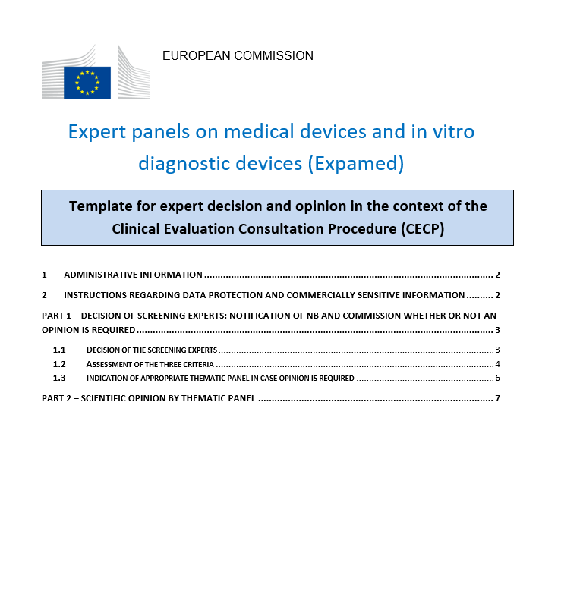
Expert consultations on MDs / IVDs: key aspects
Template for decision and opinion
Decision / opinion template outlines the aspects to be examined in the experts’ evaluation
First to be used by screening experts. In case they decide that opinion would be required, the template will be passed on to the relevant thematic panel / sub-group for development of the opinion.
Experts must state in their scientific opinion if the information submitted is not sufficient to reach a conclusion (applicable to both screening and opinion).

Slide 10
1
Actors and steps of the CECP & PECP
2
Expert consultations on MDs / IVDs: key aspects
3
Rotation of roles within experts
4
The CECP: workflow and operational aspects
5
C
Drafting opinions: aspects of confidentiality
6
C
The use of CIRCABC

Slide 11
Rotation of roles within experts
Rotation of roles from one dossier to the other
Chair
Vice-Chair
Vice-Chair acting
as rapporteur
Chair
Rapporteur
Co-Rapporteur
Co-Rapporteur
Chair can be replaced by vice-chair in case chair is unavailable or due to workload considerations
When not substituting the Chair or supporting the Chair, the Vice-chair can cover any role
Roles of rapporteur and co-rapporteur are addressed by members apart from Chair
Reasons for rotation: workload, expert contracts and budget assignment
Consequences for expert contracts: Rotation requires that experts in specific area of expertise have the same number of maximum working days in their contract

Slide 12
1
Actors and steps of the CECP & PECP
2
Expert consultations: key aspects
3
Rotation of roles within panels
4
The CECP: workflow and operational aspects
5
C
Drafting opinions: aspects of confidentiality
6
C
The use of CIRCABC

Slide 13
The CECP – summary of highly simplified workflow
NB
COM Secretariat
Experts
Dossier
upload
DOI check:
screening
Monitoring database
Screening step
Expert assignment
2 screening experts
clock start l
Screening decision
Decision
clock stop u
Uploaded decision
Communication to NB
DOI check:
opinion
Opinion step
Expert assignment
Experts in thematic panel
clock start l
Opinion
Opinion/
view
Uploadedopinion
Communication to NB
clock stop u
Justification
upload*
Publication
Post opinion
Opinion
NB justification
*) If NB does not follow panel advice

Slide 14
CECP workflow
      Screening step
The Secretariat assigns two experts without restrictions (DOI) as Rapporteur and Co-rapporteur
  In case the experts are not available they should communicate this within three days
  (in case of absences, experts should set an ‘automatic out of office’ mail)
  Experts can agree to swap roles without informing the Secretariat
Both screeners get a link to CIRCABC for accessing / downloading the CECP dossier
Secretariat contacts the screeners by e-mail and provides them with key documents and templates as well as, where available, information on criteria 2 and/or 3 and information from stakeholders
Under the supervision of the Secretariat, the two experts collaborate on assessing the dossier(s) against criteria and complete PART 1 of the decision / opinion template
If needed (e.g. no agreement possible, uncertainties regarding documentation), rapporteur contacts the Secretariat
The rapporteur uploads the completed template on CIRCABC space (this replaces EUDAMED notification)
Secretariat checks for completeness and compliance with criteria and forwards the decision to the notified body

Slide 15
CECP workflow
      Opinion step
Secretariat:
  Checks & identifies panel experts without dossier-specific COI
  Proposes to Chair identified Rapporteur/Co-Rapporteur + informs about panel members without COI
  Provides dossier access rights in CIRCABC to thematic panel members without COI
Thematic panel experts get link to CIRCABC for accessing / downloading the CECP / PECP dossier
Thematic panel experts prepare opinion using the template for Decision/Opinion. Decision making
by consensus. If not possible voting by majority with quorum. Minority viewpoints need to be documented
Secretariat monitors 60 days deadline, assigns additional experts on request of Chair and can support consensus finding (e.g. organization of tele/video conferences)
Rapporteur in agreement with Chair uploads the opinion on CIRCABC space
In case opinion cannot be delivered or not delivered in time, the Secretariat should be contacted
Secretariat uploads opinion on NB’s dossier subfolder
Notified Body decides whether to follow or not the advice. If not, NB needs to provide a justification
The Commission publishes panel opinion (and NB justification) on expert panel website

Slide 16
CECP workflow
      Important aspects for a smooth workflow
DOI: Keep DOI forms updated and forward to operational Secretariat
Availability: In case you are assigned to a rapporteur and co-rapporteur role but not available, please contact the panel Chair and the Secretariat as soon as possible (ideally within 3 working days)
Longer absences: In case of longer absences please set an ‘Out of office’ message in your contact e-mail
Panels should work autonomously during drafting and interact by e-mail: The Rapporteur and Co-Rapporteurs should provide a first draft of the opinion in collaboration with the Chair. All panel members should then contribute to their best capacity. The Chair may also distribute the drafting of more detailed aspects according to expertise available in the panel.
Additional expertise needed: Rapporteurs (screening) and Chairpersons (thematic panel) should contact the Secretariat if additional expertise is needed or in case there is no consensus
Focus on the information requirements outlined in the templates. These map the scope of your work
Expert advice delivered after deadline cannot be considered and experts will not be reimbursed

Slide 17
1
Actors and steps of CECP & PECP
2
Experts consultations: key aspects
3
Rotation of roles within panels
4
The CECP: workflow and operational aspects
5
C
Drafting opinions: aspects of confidentiality
6
C
The use of CIRCABC

Slide 18
Handling commercially confidential information
CECP / PECP dossiers may contain commercially confidential information and trade secrets
…however, the Commission needs to publish the CECP opinions and PECP views, considering aspects of confidentiality
…Therefore, the opinions and views should not detail commercially sensitive information

Slide 19
Preparation of opinions/views that respect the confidentiality requirements in regard to publication
When preparing their drafts and exchanging these by e-mail experts must observe the following 3 principles of data security and confidentiality:
No identification of actors: The text must NOT state the commercial name of the device, the NB, the MF. The only identifier allowed is the CECP dossier number provided in the template by the Secretariat.
No detailing of device: The device must NEVER be described in detail in the text.
Use only neutral wording such as “the device” or “the device under assessment”.
No details about innovations, commercially confidential information, trade secrets:
The opinion must NOT describe in detail trade secrets or innovations.
  Where needed, the innovative aspects should be described in general terms. For example, instead of specifying a new material used, it would be sufficient to state that a “the new material to cover the surfaces of the devices is claimed to improve adhesion …”
  Some degree of information will be visible in the opinions but it must NOT be detailed enough to allow conclusions on the precise nature of the innovation. Use descriptions such as “the device design is new in regard to the material used for the rigid ring of the aortic valve...”

Slide 20
1
Actors and steps of CECP & PECP
2
Expert consultations: key aspects
3
Rotation of roles within panels
4
The CECP: workflow and operational aspects
5
C
Drafting opinions: aspects of confidentiality
6
C
The use of CIRCABC

Slide 21
What is CIRCABC ?

Slide 22
CIRCABC
CIRCABC = “Communication and Information Resource Centre for Administrations, Businesses and Citizens”
Open-source, web-based application
Enables geographically spread collaborative groups
to share information and resources in private workspaces
Owned by European Commission / DG Informatics (DIGIT).
“Secure” version of CIRCABC for Clinical Evaluation Consultation Procedure (CECP) to ensure higher level of data security and privacy https://classified.circabc.europa.eu/
Help Center: https://classified.circabc.europa.eu/ui/help/start

Slide 23
EU Login
Creating and configuring your account

Slide 24
EU Login
Is the European Commission's user authentication service
Allows authorised users to access Commission web services, using a single email address and password
CIRCABC uses EU Login as authentication service
The “secure” CIRCABC requires EU Login with one of the following 2-factors authentication methods:
    Mobile Phone + SMS (preferred option)
    EU Login Mobile App PIN Code

Slide 25
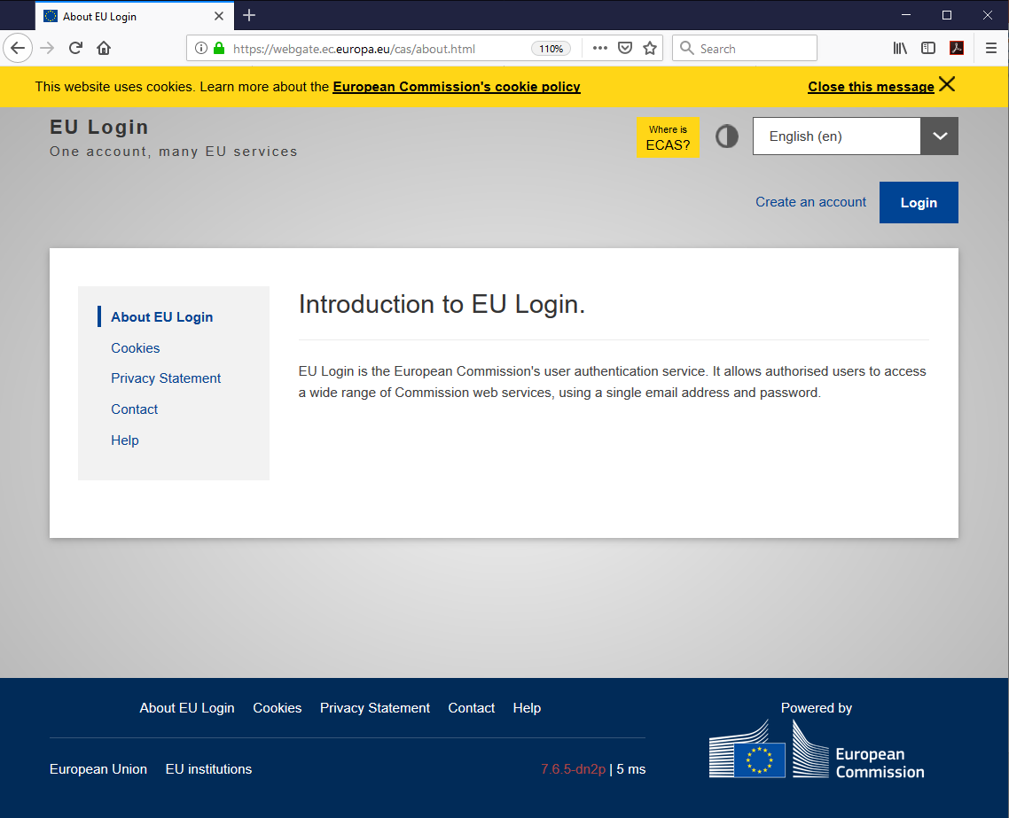
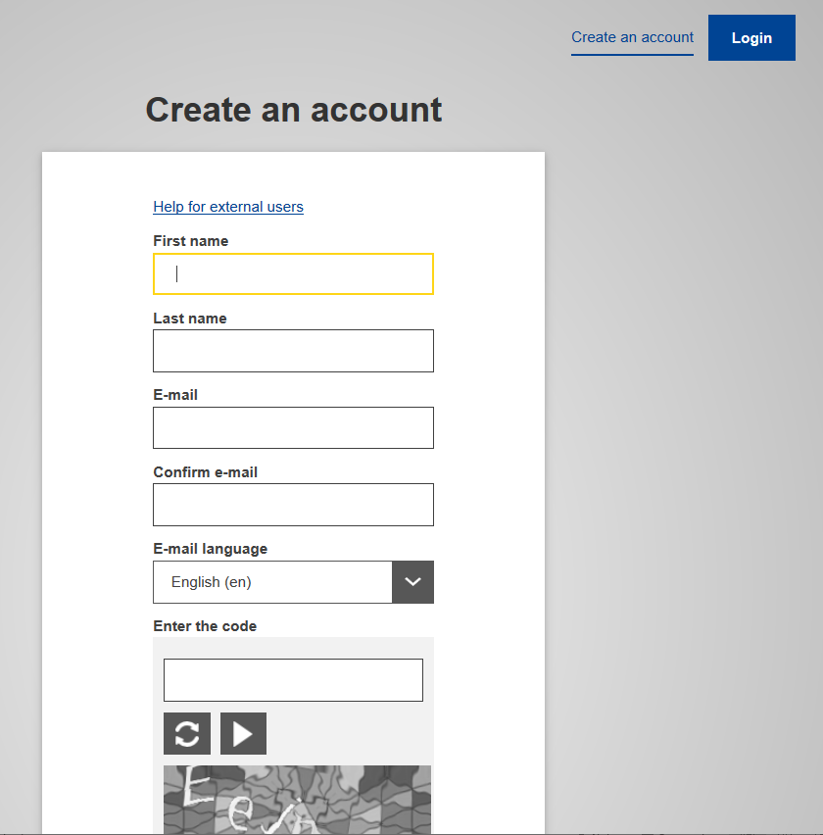
Create an EU Login account
To create a new EU Login account go to https://webgate.ec.europa.eu/cas/about.html
Click Create an account, compile the form and follow the instructions.

Slide 26
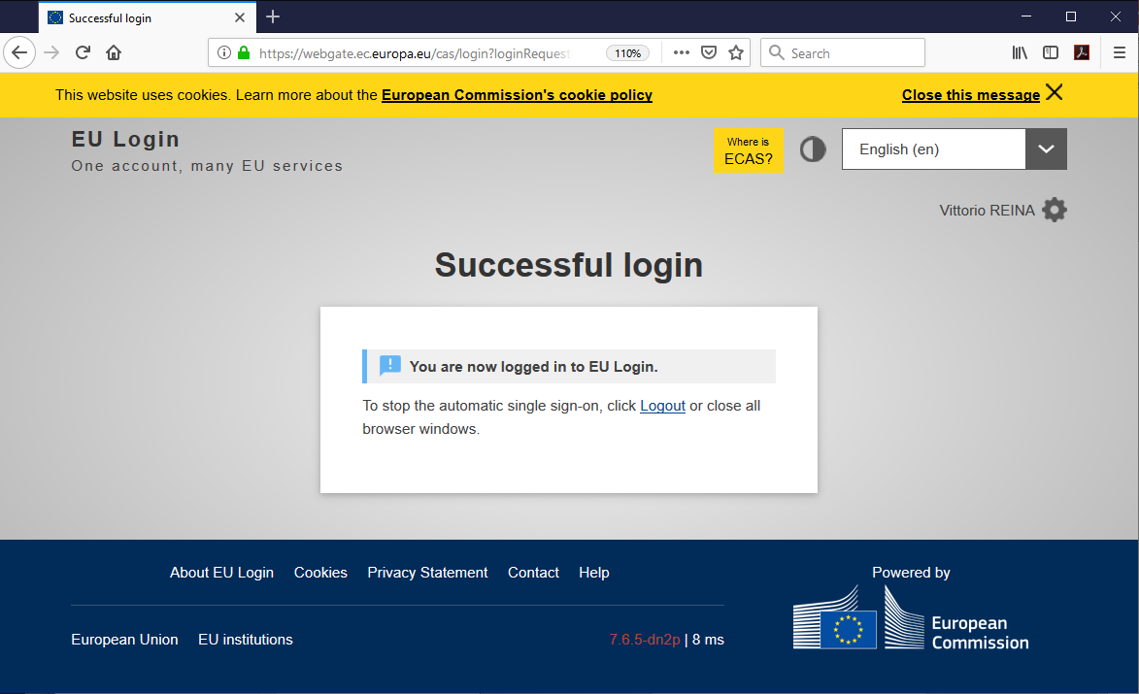
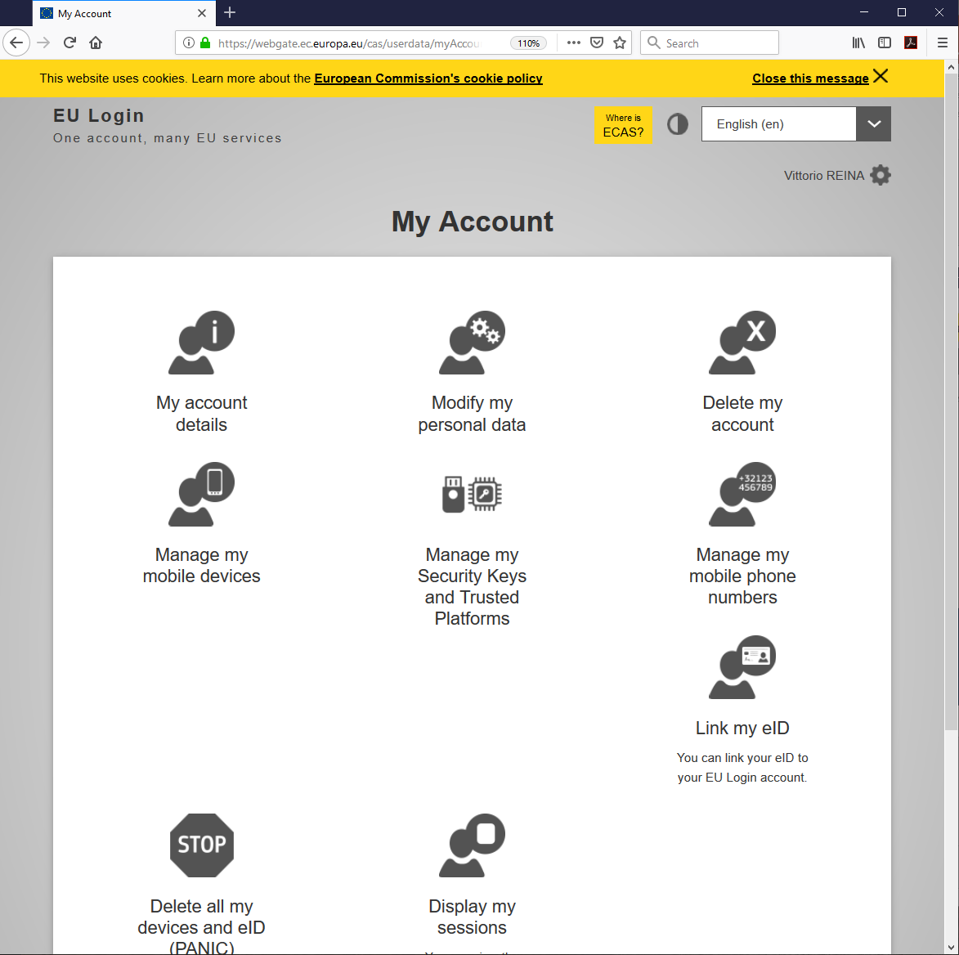
Configure your EU Login account
To configure your EU Login account go to https://webgate.ec.europa.eu/cas/about.html
Click Login, type your password and click Sign in
When you are logged in, click the gear icon beside your name to access My Account page where you can configure your account (e.g. personal data)

Slide 27
Add your mobile number for the 2-factor authentication
A mobile phone number is necessary for the 2-factors authentication to access the CECP PECP Expert Panels Interest Group
Access My Account page to add a mobile phone number to your profile
In My Account page click Manage my mobile phone numbers, insert your password and mobile phone number and click Sign in
You will receive an SMS with a code. Insert it in the required fields and click Sign in to finalise the operation

Slide 28
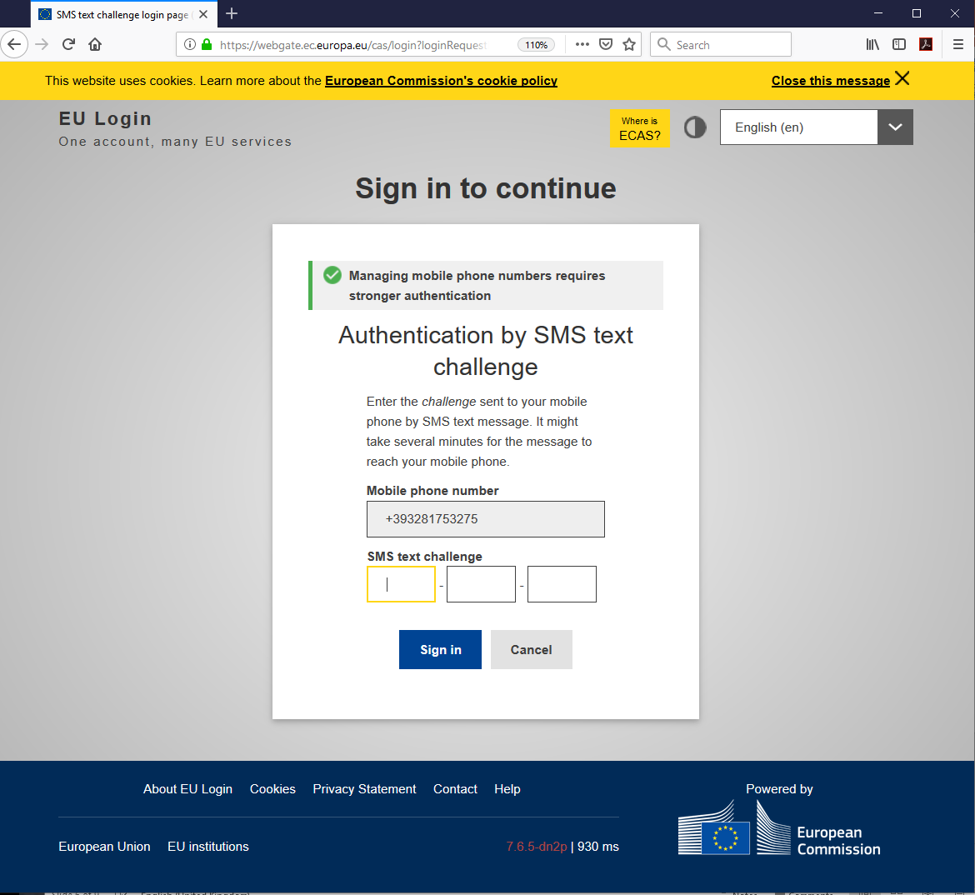
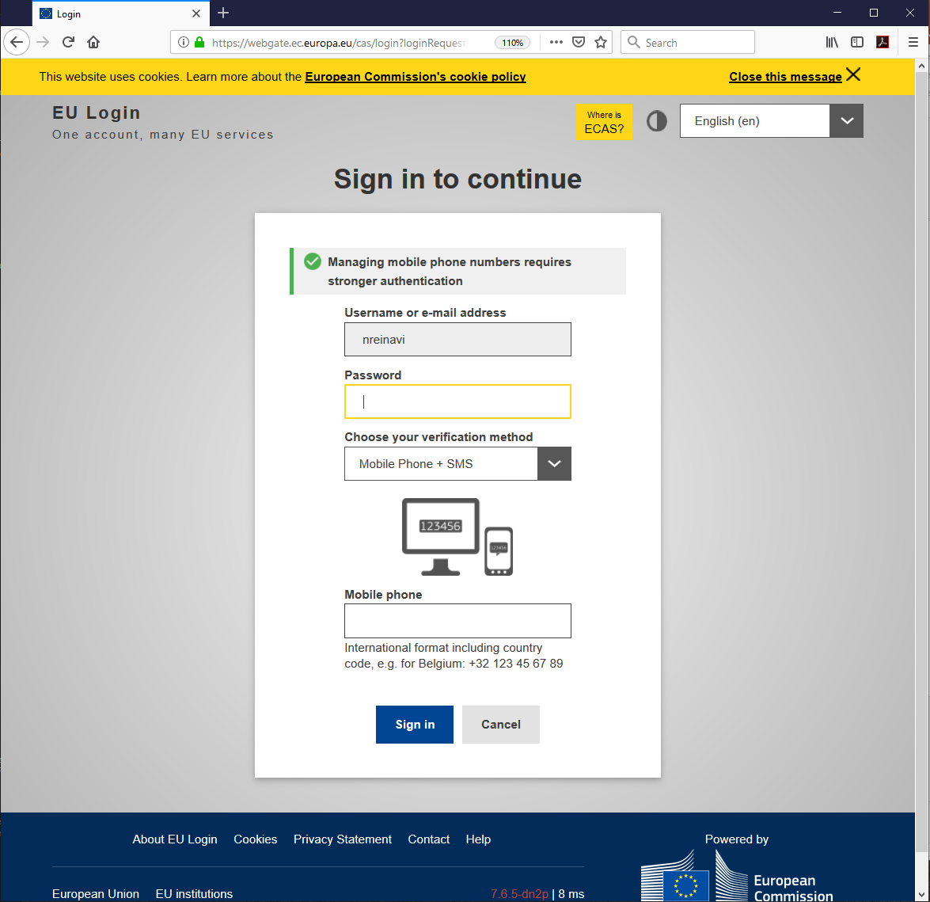

Slide 29
Accessing the CECP PECP Expert Panels Interest Group

Slide 30
CECP PECP Expert Panels Interest Group
The CECP PECP Expert Panels Interest Group is accessible at: https://classified.circabc.europa.eu/ui/group/313a8bbb-b442-4c04-a4d6-eb7bc78e323f
Type your password, select Mobile Phone + SMS, insert the mobile phone associated with your account and click Sign in
You will receive an SMS with a code. Insert it in the required fields and click Sign in to finalise the operation and access the homepage

Slide 31
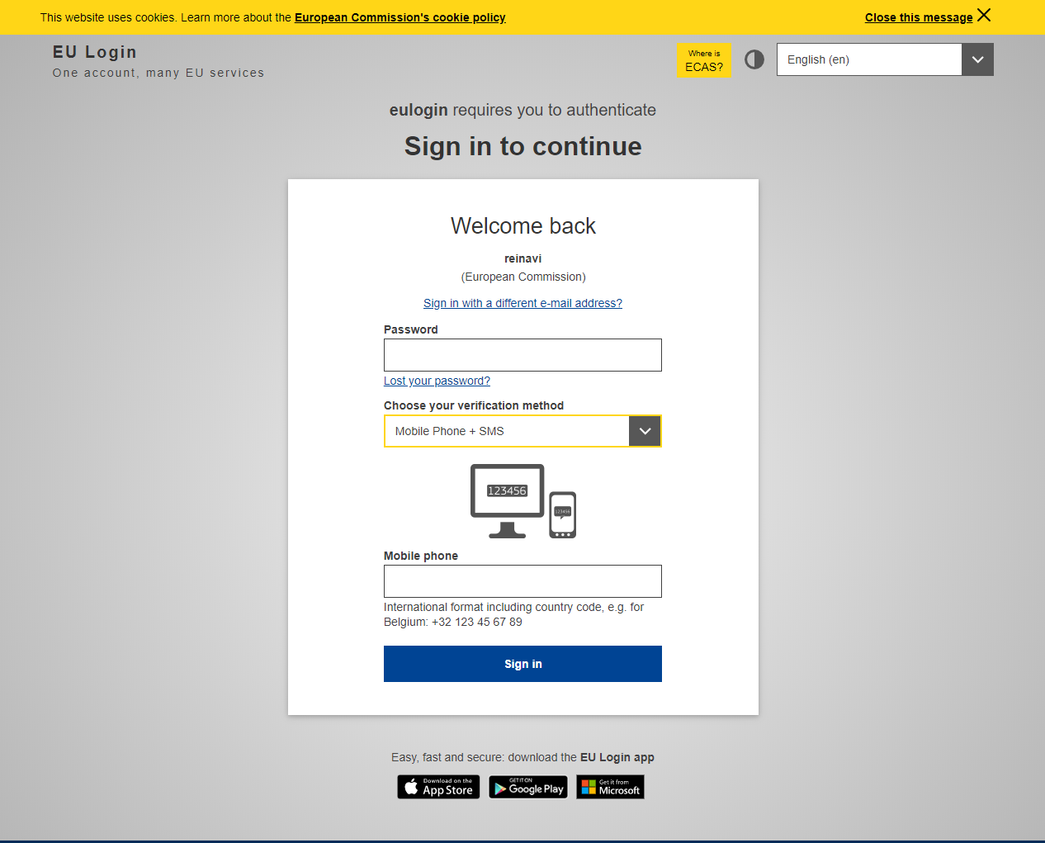
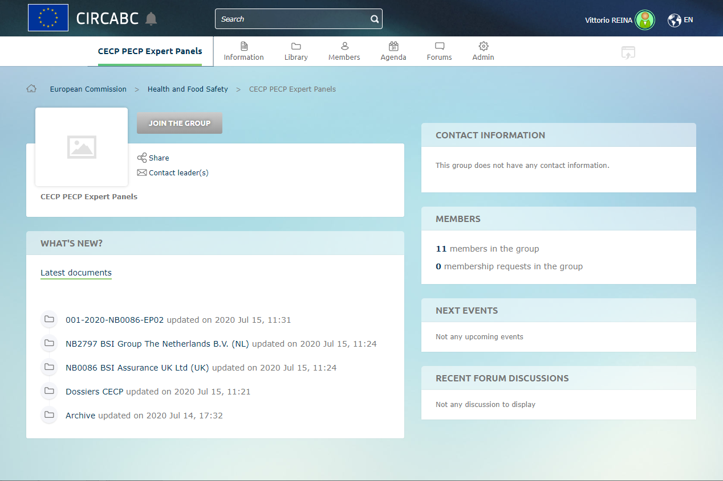
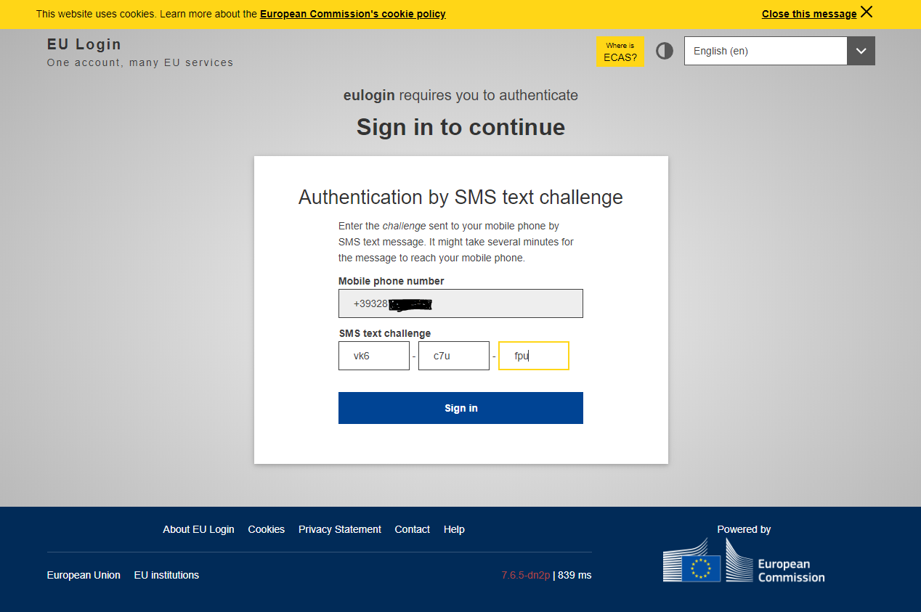

Slide 32
Managing files
How to download and upload files

Slide 33
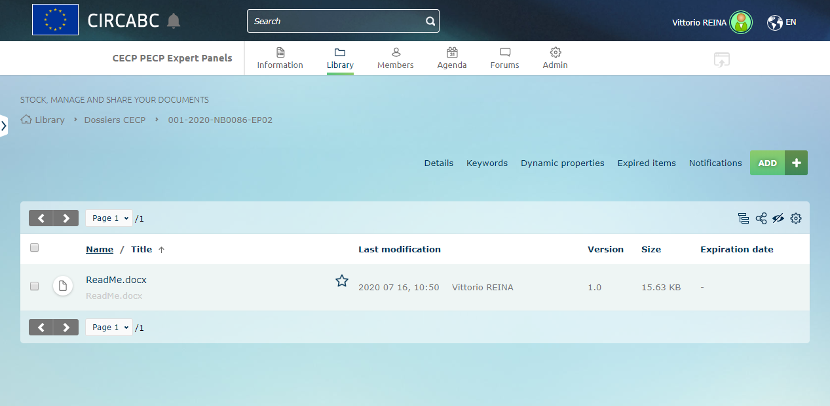
Managing files
Files in CIRCABC are stored under the section Library and are organised in folders and sub-folders
You only see folders for which you have access rights
Position of current folder

Slide 34
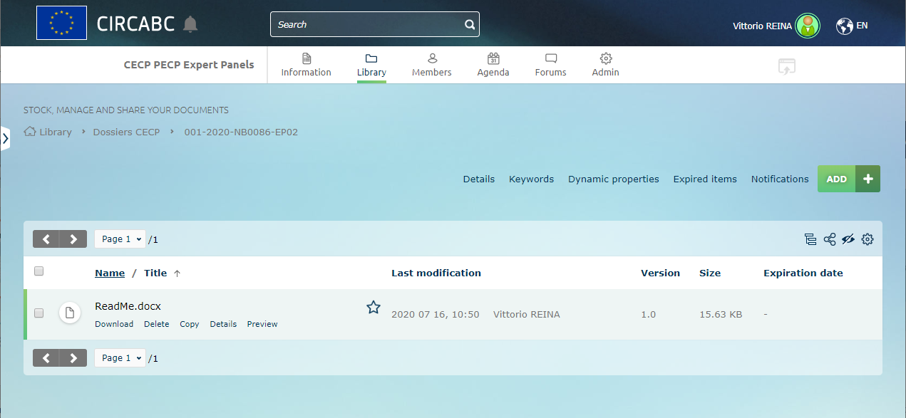
Download files (1/2)
download
If you need to download one file, place the mouse on the name of the file
A submenu appears with several actions (according to your access rights), click Download

Slide 35
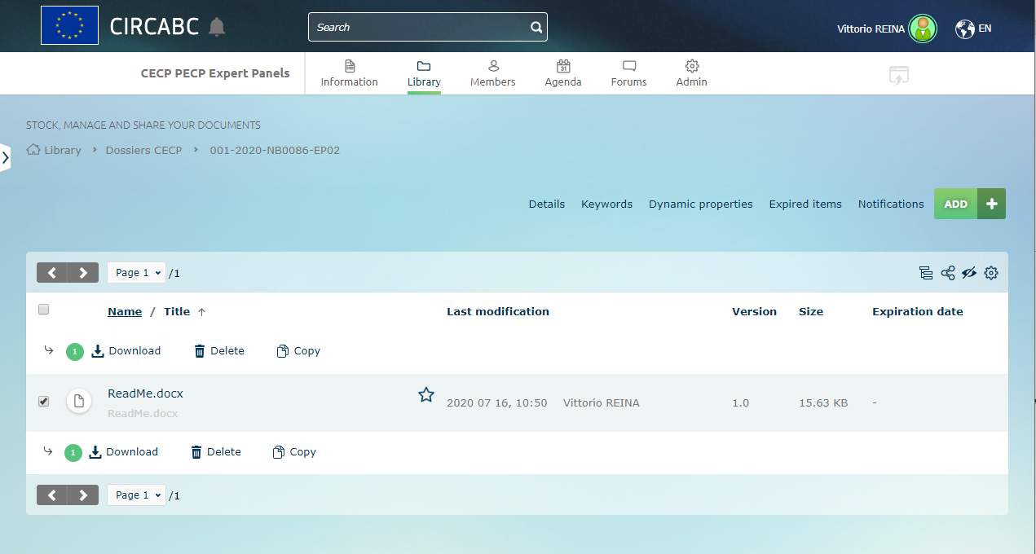
Download files (2/2)
download
If you need to download multiple files, select the files using the checkbox on the left of the filenames
When all the files are selected, click Download.

Slide 36
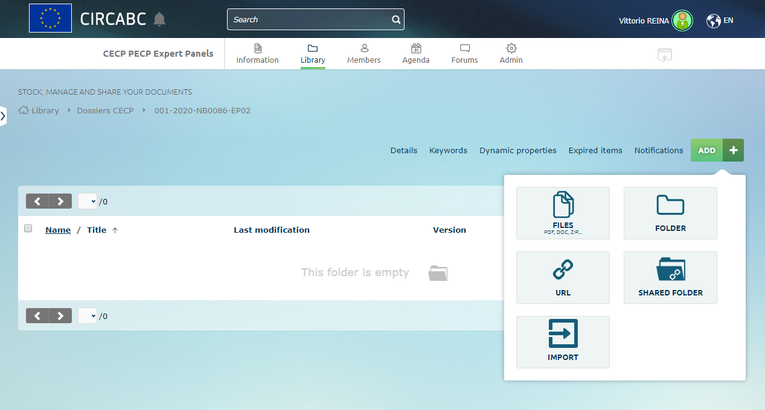
Upload files (1/2)
Upload
From Library go to the desired folder. Click ADD and then FILES.

Slide 37
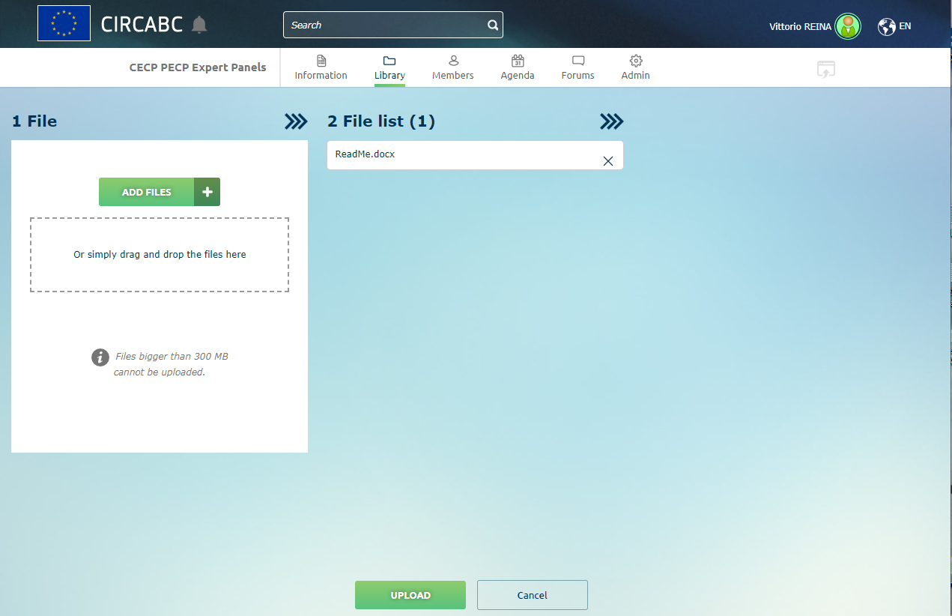
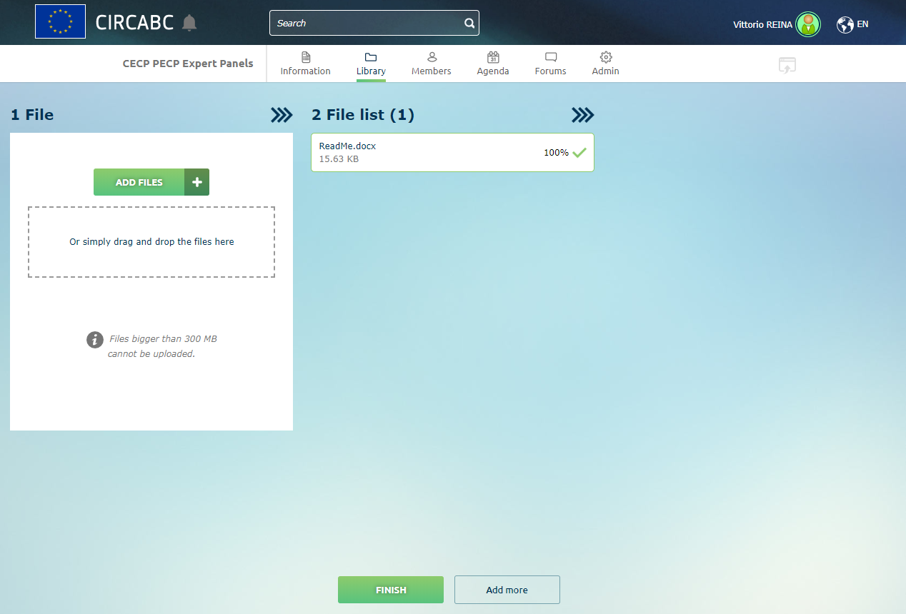
Upload files (2/2)
Upload
Select the file(s) to be uploaded by clicking ADD FILES or simply dragging and dropping the file(s) in the dashed area, click UPLOAD and then FINISH.

Slide 38
Notification emails from CIRCABC

Slide 39
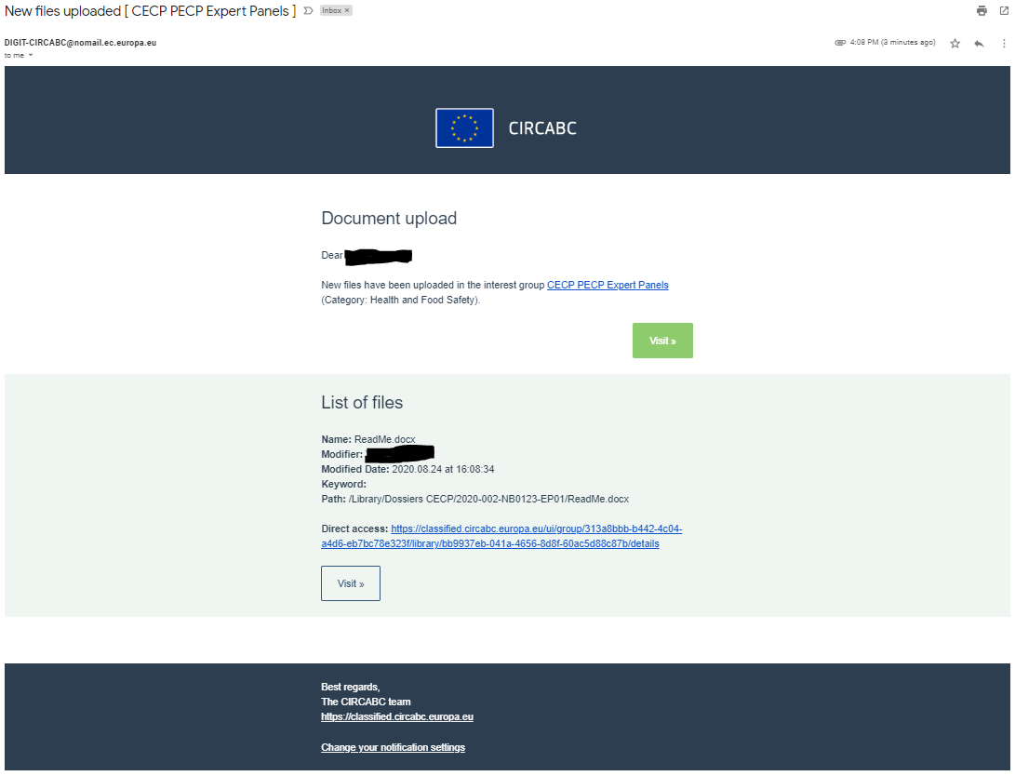
Notification emails from CIRCABC
Whenever the content of a folder is modified, CIRCABC sends notification emails. These
notifications allow you to
Access the modified folder (e.g. new file uploaded) by clicking the button Visit coloured in green
Access the file quickly by clicking the Direct access URL or the button Visit not coloured (you will be prompted to log in to ECAS)

Slide 40

Thank you
© European Union 2020
Unless otherwise noted the reuse of this presentation is authorised under the CC BY 4.0 license. For any use or reproduction of elements that are not owned by the EU, permission may need to be sought directly from the respective right holders.

